Slide 1
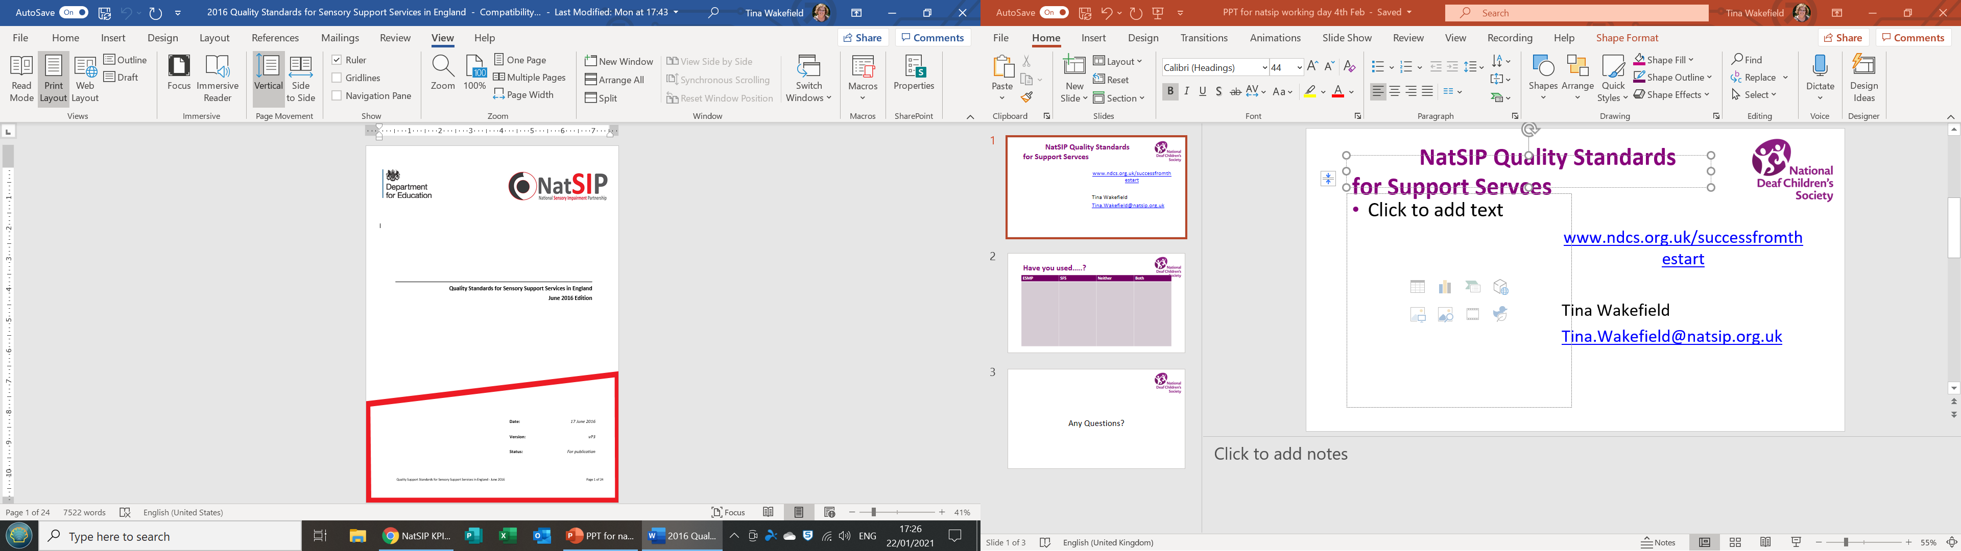
NatSIP Quality Standards for Support Services
Next steps?
Tina Wakefield
Tina.Wakefield@natsip.org.uk

Slide 2
The current Quality Standards
Written in 2016 and linked to the Ofsted/CQC Handbook
Funded by the DfE under a grant given to NatSIP
So… they currently have the DfE and the NatSIP logo
NatSIP Website says that they have been downloaded 2081 times!

Slide 3

How have they been used by services?

Slide 4
Support
Support services in self evaluation of the provision they make
Enable
Enable staff, leaders and managers to consider responsibilities and roles
Help
Help parents and carers to understand what they might expect to be in place
Support
Support service improvement planning
Include
Include their partnership working with CYP, parents and carers and other agencies.

Slide 5
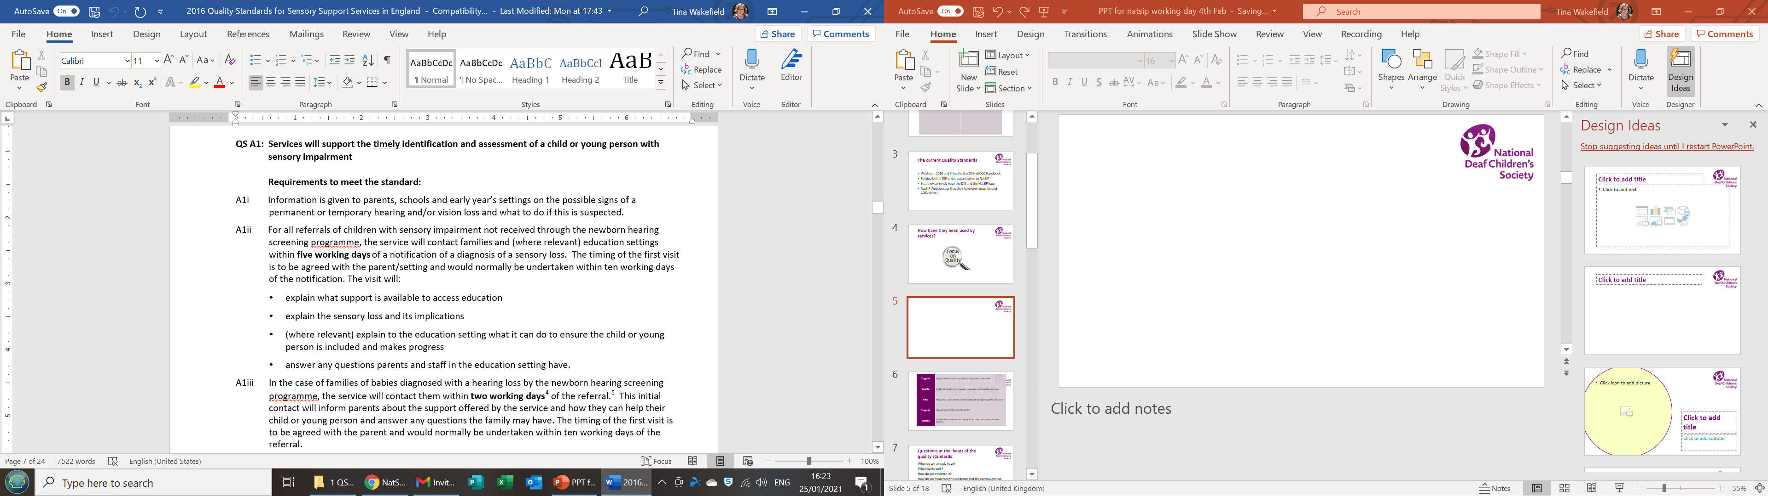
Notes:
Quick examples QS A1

Slide 6
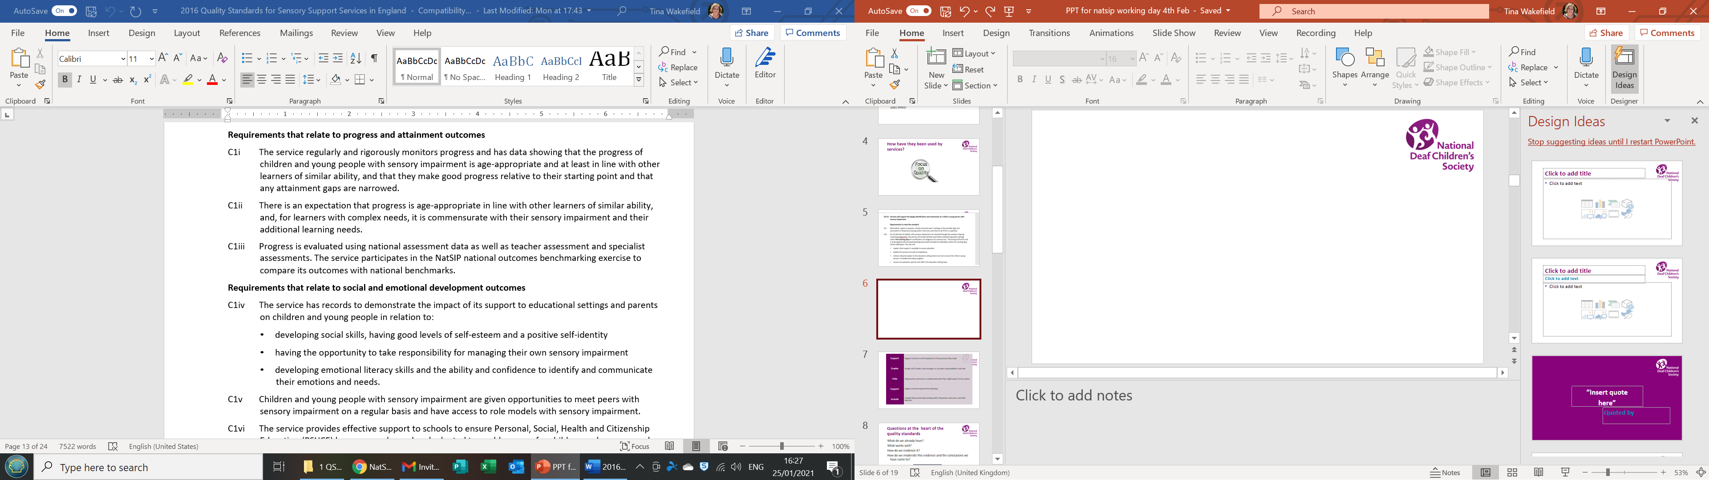
Notes:
QS CC 1

Slide 7

Questions at the heart of the Quality Standards
What do we already do?
What works well?
How do we evidence it?
How do we moderate this evidence and the conclusions we have come to?

Slide 8
Two linked documents
1) Quality Improvement Support Pack 2016 (1811 downloads) –
Examples of evidence from services
Links to documents used by services
Self audit tool (PDF)
2) Quality Improvement Self Audit Tool, Word Doc (910 downloads)

Slide 9
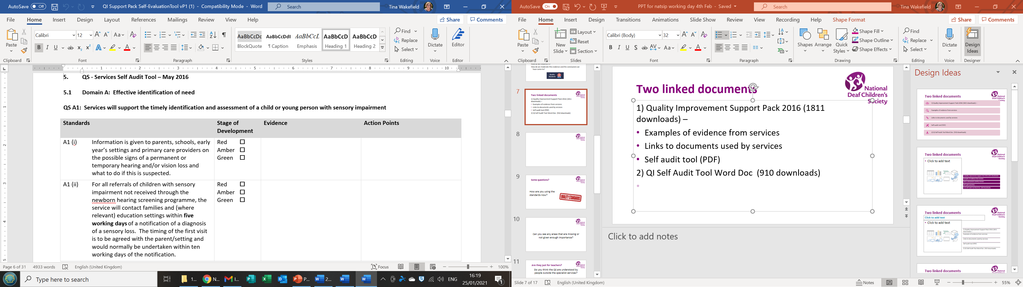
Notes:
Example of tool kit

Slide 10

Some questions?
How are you now using the standards?

Slide 11
Can you think of any areas that are missing or not given enough importance?

Slide 12
Do you think the QS are understood by people outside the specialist services?
Families?
Commissioners?
Audiologists?
Is this important?

Slide 13
The QS standards are currently SI
Should we continue to write for all the forms of sensory impairment, or is there a case for separate standards for HI, VI and MSI?

Slide 14
Quality improvement
The quality standards are accompanied by a quality improvement pack and toolkit.
Are these useful?

Slide 15
Structure of the standards..
The quality standards are now based around the inspection framework for the Ofsted local area inspections.
Should we continue to follow this approach?
Does it matter?
Is this important to commissioners?

Slide 16
Any other thoughts?

Slide 17

QS help us to do our best!

