Slide 1

DfE update and lessons learned about SEND delivery - what has worked and what hasn’t
NatSIP National Working Day and HoSS Event
Thursday 4 February 2021
André Imich, SEN and Disability Professional Adviser, DfE

Slide 2
Areas covered
A) Covid
What we have learned
Moving forward
Ongoing issues and concerns
B) SEND Business as Usual - Updates

Slide 3
Attendance Autumn Term 2020
Approximately 80% of all pupils with an EHCP on roll in all state-funded schools were in attendance on 10 December.
Fewer pupils were in attendance at state-funded special schools (77%) than state-funded primary and secondary schools.
Attendance was highest in the SW, SE and East of England throughout most of the autumn term.

Slide 4
Ofsted briefing re schools, Dec 2020
CYP with SEND were less likely to be attending their schools and colleges than their peers this term.
Some barriers were: anxieties about the pandemic felt by parents and carers, and the CYP themselves; medical needs that required them to shield; problems accessing transport.
Not all schools and colleges were delivering a full curriculum; some CYP with SEND were on part-time timetables.
Special schools and APs used online learning often for keeping in touch with pupils rather than as a vehicle for teaching.
MS and special schools reported that not all external services and therapies (OT, physio and specialist teachers) had resumed operating, particularly face to face – “a significant impact”
Ofsted COVID-19 series: briefing on SEND, November 2020 Evidence from education, health and social care leaders and practitioners between Sept and 4 December 2020

Slide 5
November wave of DfE COVID-19 Parent and Pupil Panel
3,388 parents and 1,612 secondary pupils – all mainstream.
Remote learning - pupils with SEN are less engaged, hear less from their schools and are less likely to be offered remote learning. Their parents are under considerable pressure from providing additional care.
Return to school - pupils with SEN have felt less safe, more likely to be the victims of bullying and suffer worse mental health.
Note - This report is not yet published and this slide is not for wider circulation

Slide 6
Disabled Children’s Partnership (DCP) - Back To School Poll
Survey of 3,400 parents of disabled children in Nov.
24% of disabled children were not back in school at all or were attending part-time.
47% of children with EHC Plan were getting none or just parts of the support specified in the plan.
57% of children who received social care, e.g. short breaks, before lockdown, had not had this fully reinstated.
70% of children who received specialist help such as specialist teachers, physio, SaLT, and OT, had not had this fully reinstated.

Slide 7
Support from sensory impaired services – March to July 2020 - examples
Teachers of the Deaf have designed individual programmes, to be delivered remotely, for deaf children who would otherwise have received one to one withdrawal support in schools
Radio aids are available to families in the home if they wish this.
The service is delivering a ‘Home communication package’ that is delivering signing via Facetime, Zoom or Skype.
Our VI teachers are still in conversation with SENCOs in schools and ensuring that any work sent home is appropriate.
The Early Years specialist sensory VI teachers have put together guidance for supporting under 5s during this time.

Slide 8
School and college opening Spring 2021
Colleges, primary and secondary schools will remain open for vulnerable children and the children of critical workers.
All other children will learn remotely.
Receiving face-to-face education is best for children’s mental health and for their educational achievement. Limiting attendance is about continuing to support the reduction in the overall number of social contacts in our communities.
For vulnerable CYP and the children of critical workers still attending school or college, and their teachers, the system of protective measures means that any risks are well managed and controlled.
The Royal College of Paediatrics and Child Health recently made clear that the overwhelming majority of CYP still have no symptoms or very mild illness only.

Slide 9
Vulnerable CYP include:
In need under section 17 of the CA 1989, including CYP who have a child in need plan, a child protection plan or who are a LAC
Have an EHC plan
Have been identified as otherwise vulnerable byschools or LAs, e.g. :
CYP on edge of receiving support from children’s social care services
adopted children or children on a special guardianship order
those at risk of becoming NEET
those living in temporary accommodation
those who are young carers
those who may have difficulty engaging with remote education at home (e.g. due to a lack of devices or quiet space to study)
care leavers
others at the provider and LA’s discretion including CYPs who need to attend to receive support or manage risks to their mental health
Clinically vulnerable children and young people

Slide 10
Laptops
More laptops and tablets now available
Get help with technology programme provides hundreds of thousands more laptops and tablets – reaching a total of more than 1 million by the end of the academic year
All schools, colleges, trusts and LAs can order devices before they experience disruption to face-to-face education
DfE to provide more detail in spring term 2021.
Schools can order devices for disadvantaged children:
in Y3-11 who do not have access to a device and whose face-to-face education is disrupted
in any year group who have been advised to shield

Slide 11
Wellbeing for Education Return - Update
Helps local areas to support schools and FE providers promote wellbeing and good mental health, responding to the impacts of Covid-19.
More than 15,000 education settings are being offered additional training and support.
DFE now working with the Anna Freud Centre to develop webinars that can delivered directly to education settings that haven’t received training from LAs.
Will distribute two pre-recorded two webinars, that cover child wellbeing and resilience and covering staff wellbeing.

Slide 12
Use of PPE
The majority of staff in education settings will not require PPE beyond what they would normally need for their work.
PPE is only needed in a very small number of cases, such as:
where an individual child or young person becomes ill with coronavirus symptoms while at school, and only then if a distance of 2 metres cannot be maintained;
where a child or young person already has routine intimate care needs that involves the use of PPE, in which case the same PPE should continue to be used.
When working with children and young people who cough, spit or vomit but do not have coronavirus symptoms, only any PPE that would be routinely worn, should be worn.
Guidance for full opening: special schools and other specialist settings

Slide 13
Catch up support
£650m to ensure pupils have the chance to catch up - a one-off grant to all state-funded primary, secondary and special schools in the 20-21 academic year.
Headteachers to decide how the money is spent.
EEF: guidance on effective interventions to support schools.
For pupils with complex needs, settings to spend this funding on catch up support to address individual needs, inc. SaLT, travel training, EP time, or other small group/ individual interventions.
Information about distribution of funding to settings due shortly.
Also a £350m National Tutoring Programme to deliver tuition to the most disadvantaged and vulnerable young people.
Guidance for full opening: special schools and other specialist settings

Slide 14
Stakeholder Feedback – January 2021
Special Needs Jungle – 25 Jan 2021
Schools are, on the whole, doing much better this time round, with more children in school and more experience of handling pandemic education.
However, other parents say schools are deciding for themselves who they will allow in.
NNPCF – 22 Jan 2021
More vulnerable children and children of key workers are being offered places than in the first lockdown and more are taking those places up.
Examples of families being discouraged to take up places.
Some special schools have adopted a good coproduction based approach, working with families to understand what provision they need and how this can be supplied.
Others have taken unilateral decisions based on prioritisation criteria that have been implemented without consultation.

Slide 15
Attendance on 28 January in state funded schools
All Schools:
22% - primary schools
5% - secondary schools
33% - special schools.
Vulnerable groups
36% of all pupils with an EHCP
43% of all pupils with a social worker
Among open special schools:
4% less than 10% attendance,
22% less than 20%;
86% less than 50%;
14% were over 50%
% Attendance | Special schools
<20 | 20%
21-50 | 64%
> 50 | 18%

Slide 16

Gary’s school rang this morning to find out if we would like him to go to school. They will accommodate him five days a week. I do so reluctantly but it is better for him. He is so excited about school that he has packed his lunch and his bag ….a first for us!
For my son, the last two lockdowns he really struggled with the work at home and the lack of routine. He is at school this time and the difference in him is amazing. Not autistic but thrives with a routine.
Luke is loving being at school. it is very much appreciated. thank you from all of us
I don't want to hear any billy balls about all vulnerable children will be able to go to school. Many with an EHCP in desperate situations could not access education last time and it's already shaping up to be a repeat for some.
My son’s special school is closed to all except key workers and most vulnerable. Last lockdown about 11 children attended (it's a huge school with 300 pupils). how do parents challenge this?
Alison is now going to school and she definitely needs the routine and her friends. She was also adamant mum wasn't going to teach her this time.

Slide 17
Encouraging the attendance of vulnerable children
Vulnerable children and young people who have not attended their setting following the introduction of national restrictions can revisit that decision at any point in time
Parents, carers and young people should talk to their education setting and social worker (if they have one) if they wish to do so.
Education settings should also continue to encourage vulnerable children to attend and review whether there are other children and young people who might be newly vulnerable and benefit from on-site attendance.

Slide 18
Specialist and visiting practitioners
Settings should minimise numbers of visitors.
Visiting specialists such as therapists, clinicians, peripatetic teachers and other support staff for pupils with SEND should provide interventions as usual.
Can move between settings as required.
Visitors may also include NHS staff, e.g. those delivering vaccinations as part of the national childhood immunisation programme.
Such specialists will be aware of the PPE most appropriate for their role.
Letter from Minister Ford to CYP with SEND, their families and carers, and those who work to support them - Sept 2020

Slide 19
Remote learning (DfE Omnibus Survey Dec 2020)
Summary - Pupils with SEND may have access to a laptop but continue to be less engaged in home learning, hear less from their schools and their parents are having to provide more support.
Parents of pupils with SEND were much more likely to say their child found home learning difficult than parents of pupils without SEND
Parents of pupils with SEND were much more likely than parents of pupils without SEND to say that they provided a lot of support.
Parents of pupils with SEND were much more likely to say that the following learning types were not effective:
  Online worksheets
  Paper worksheets
  Recommended reading of books
  Recommended reading of online resources.

Slide 20
NNPCF – Key messages
School places must be made available to vulnerable CYP including those with EHCPs.
Needs to be an increased focus on CYP on SEN Support.
Ensure that remote education provided is differentiated and that the appropriate support is provided.
If it is impossible for schools and other services to deliver all the services in an EHCP, there must be an open and honest conversation with families to coproduce what services are possible to deliver and what alternatives can be put in place.

Slide 21
SEND Business as Usual
Update

Slide 22
SEND Review - Update
Has identified three key areas of focus:
High quality outcomes supported by the most appropriate service across education, health and care.
Back mainstream schools to better meet the needs of the majority of children with SEND.
Make the EHCP process streamlined and consistent, and increase capacity in the specialist sector to place children close to home, at a sustainable cost.
Co-production with CYP, their families and carers to continue being the underpinning principle across the system
Review to be published as soon as is practicable to do so

Slide 23
Assessments/ reviews
Annual review – timeliness of completion.
School phase transfers (e.g. Y2, Y6) by 15 Feb.
Post-16 transfers - LAs must have issued final EHC plans in line with 31 March timescales.
Essential for all phase transfers to be completed on time so that preparations for Sept can be finalised.
Reminder of importance that provision sections of EHC plan “must be detailed and specific and should normally be quantified”.

Slide 24
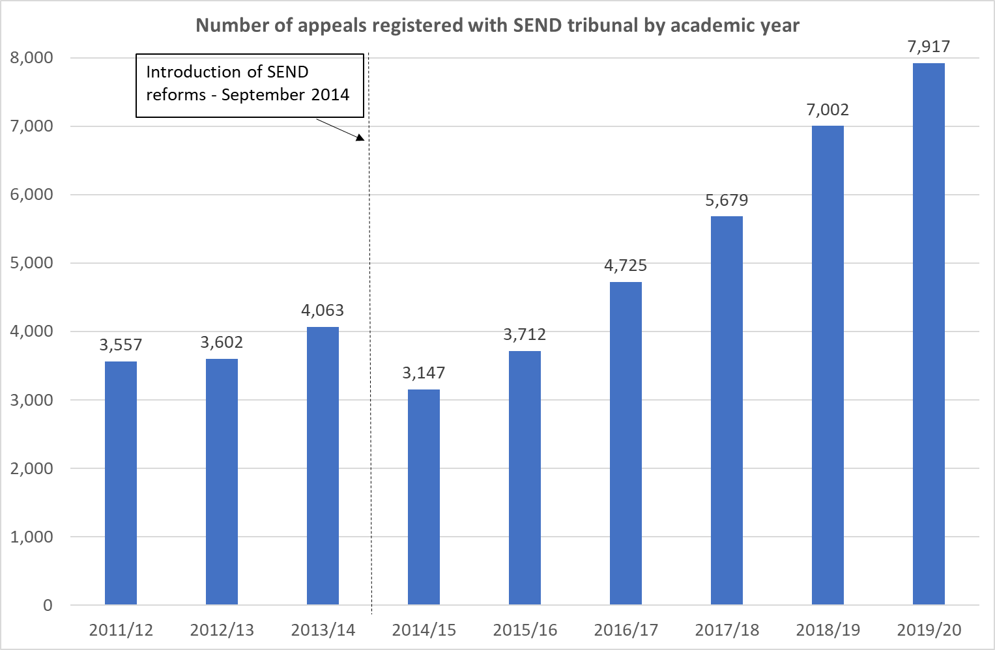
Appeals to Tribunal –
2019-20 data
In 2019/20, 7,917 registered appeals in relation to SEND.
An increase of 13% compared to 2018/19.
29% were against refusal to secure an EHC assessment.
58% were in relation to the content of EHC plans.
ASD accounts for 47% of all SEN appeals.
1,139 (of the 7,917) appeals were appeals under the Trial - an increase of 908 from 2018/19.
322 appeals for Health, 228 for Social Care and 589 for both.

Slide 25
Redress decisions
Published summaries of National Trial decisions issued by the First-tier Tribunal SEND:
September 2018 – December 2018: Summary of NT Decisions - Q1 .pdf / 333.32kB
January 2019 – March 2019 (Q2): Summary of NT Decisions - Q2 .pdf / 982.97kB
April 2019 – July 2019 (Q3): Summary of NT Decisions - Q3 (newly published)

Slide 26

An opportunity to discuss SEN issues
(a) Covid related
and/or
(b) Business as usual

Slide 27
Testing
The rapid testing programme for secondary schools and colleges will continue for those on site. All secondary schools and colleges will be expected to test their students as they return to school/college - two lateral flow tests, three to five days
Staff in primary and secondary schools, and in all colleges, now have access to two tests per week, which will continue when schools and colleges open fully.
In the light of NHS Test and Trace and Public Health England advice, we are pausing daily contact testing in all but a small number of secondary and special schools and colleges, where it will continue alongside detailed evaluation.

Slide 28
Free school meals
Providers should continue to support students who are eligible for FSM, even if students are studying remotely. This could include:
providing lunch parcels through school catering team or food provider;
providing vouchers for a local shop or supermarket;
using the DfE national voucher scheme.
Vulnerable families will continue to receive meals and other essentials over half term via councils through the £170m Covid Winter Grants Scheme.
This scheme also applies to CYP not on a school roll.
We will prolong arrangements for providing FSM for those eligible children not in school (including food parcels and the national voucher scheme) until they have returned to the classroom.

Slide 29
Elective home education (EHE)
“EHE should always be a positive choice taken following a discussion between parents the school, and the LA about how the needs of the child might best be met. This is particularly important where vulnerable children, children in need, and those at greater risk of harm are involved.”
LA survey returns from 110 LAs in Oct 2020 shows that, since 1 September, for CYP with EHC plans, there were:
335 new requests for EHE
Average number per LA is 3
19% of LAs have 0 requests
Letter from Minister Ford to CYP with SEND, their families and carers, and those who work to support them - Sept 2020

Slide 30
Extending provision set out in an EHC plan
No CYP is expected to need to repeat a year of educational provision as a result of the coronavirus outbreak.
This also applies to those with EHC plans – it is not anticipated that YP will need to remain in education any longer than originally set out in their plan.
In a few cases, it may be appropriate for a CYP to extend their current educational provision or have their EHC plan extended, perhaps for an individualised programme for a term or ½ term.
In all circumstances, this would need to be decided by the LA, following a review of the CYP’s needs and EHC plan.
School funding regulations do not allow for those over 19s to remain in a school, unless given exceptional approval by SoS.
Guidance for full opening: special schools and other specialist settings

