Slide 1
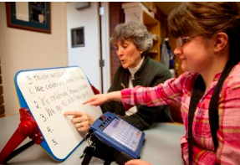

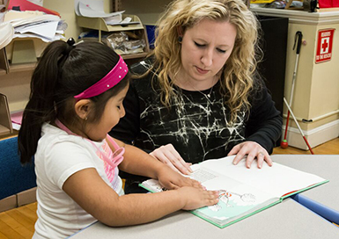
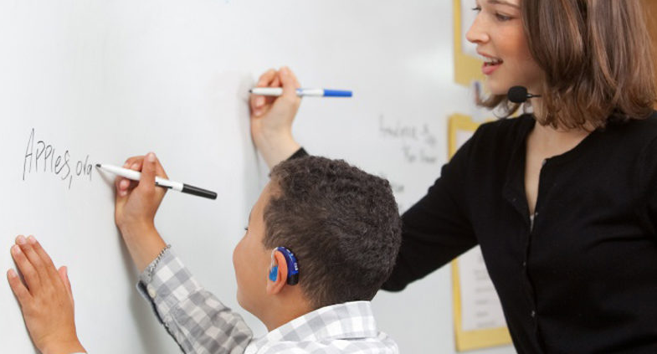
Developing a new apprenticeship pathway for teachers of the sensory impaired

Slide 2
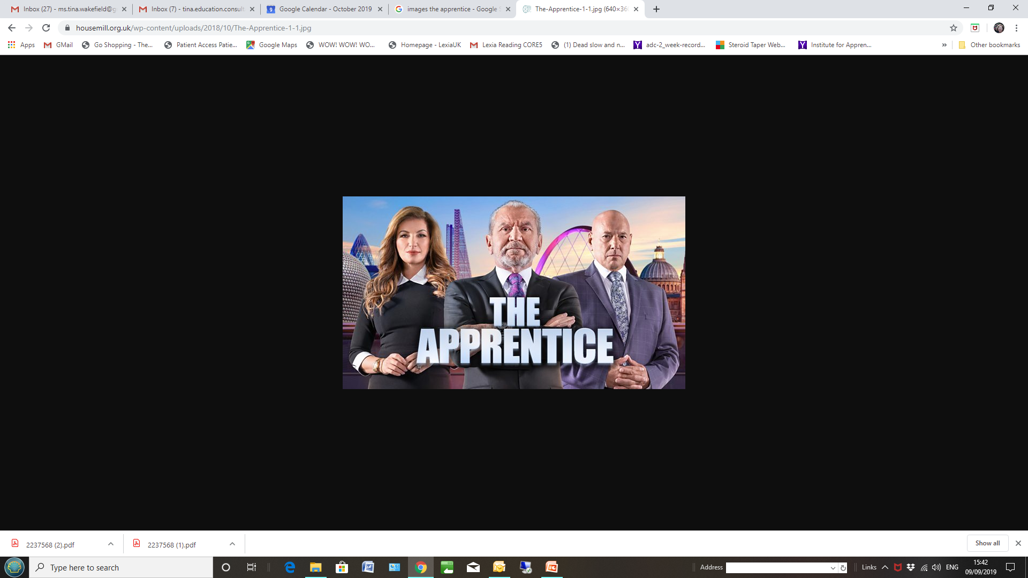

Slide 3
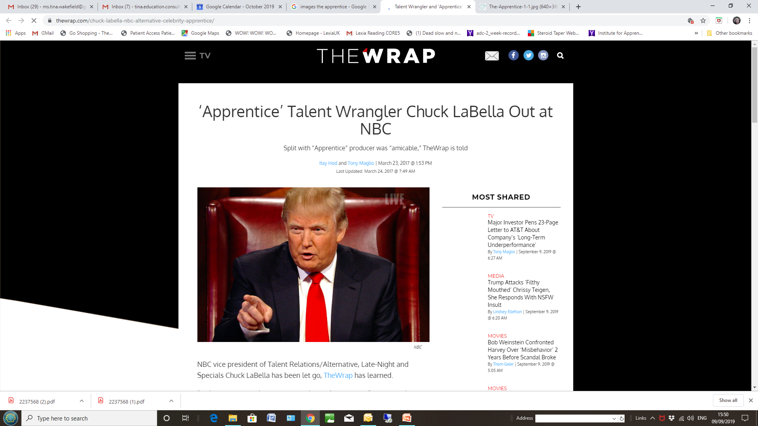

Slide 4
Why apprenticeships?
The concept of apprenticeships have been around for hundreds of years.
In the past, apprenticeships were geared towards traditional vocational courses such as plumbing or carpentry, there wasn’t the same breadth of roles available to undertake that there is today.
There is an increasing the range of sectors now covered, including digital, finance and media.

Slide 5
Apprenticeships combine practical training in a job with study.
An apprentice:
works alongside experienced staff
gains job-specific skills
earns a wage and gets holiday pay
gets time for study related to the role (usually one day a week)

Slide 6
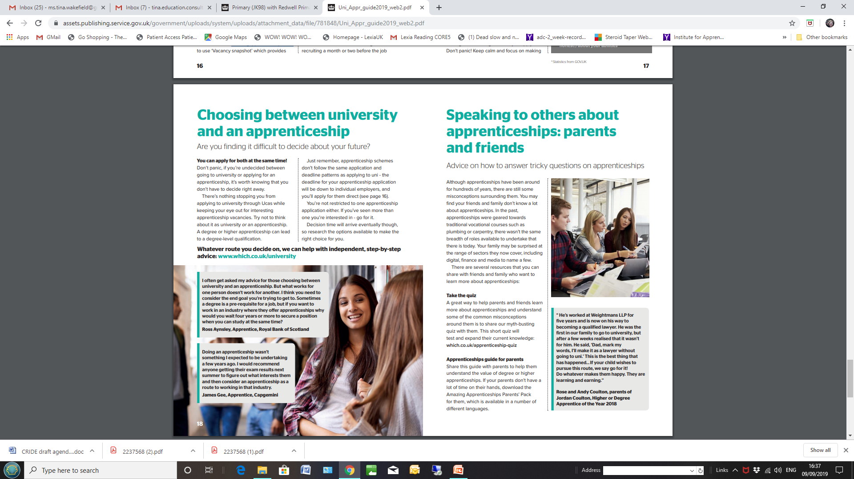
Over 80 Universities are now involved in delivering training
Including -
University of Birmingham
University of Hertfordshire
University of Leeds
University of Manchester

Slide 7
Over 200 roles are presently covered by apprenticeships and the number is growing
...
Postgraduate Engineer
Professional Economist
Professional Science Industry Process
Plant Engineer
Public Sector Commercial Manager
Registered Nurse
Rehabilitation Worker (Visual Impairment)
Social Worker
Software developer
Teacher
Technician Scientist..............

Slide 8
Mainstream teacher apprenticeship
Has been established since 2017
Has links with universities and other registered training providers to deliver training
Starts with initial generic training then splits off into detailed work on either primary, secondary or further education..
Usually a one year PG course
Level 6 , funding of up to £9000 granted

Slide 9
Teacher of sensory impaired children
Proposal -
the numbers involved in SI training, if split into three different apprenticeships, would be too small for an individual apprenticeship standard
so, it would be an initial small core set of duties for all SI teachers, then splitting into the three specific individual options for HI, VI or MSI
SI apprenticeship would co-exist with the current MQ as they are completely separate training systems – although they could use the same provider.

Slide 10
One of the great attractions of an apprenticeship scheme – the funding!
Quite complicated! Linked to the apprenticeship levy.
An employer who has an annual pay bill over £3 million each year, must pay the government an apprenticeship levy of 0.5% of their annual pay bill.
Employers who are not over 3 million, will have an apprenticeship levy allowance of £15,000 each year.
For voluntary-aided schools, foundation schools, free schools and academies, the governing body is the employer. Each governing body will be entitled to an allowance of £15,000.
For other maintained schools, the local authority is the employer.
Notes:
For 3 million – 0.5% is 15000 One la or MAT has one allowance of 15000.

Slide 11
Funding (again)
Levy-paying employers create an apprenticeship service account to: receive levy funds to spend on the apprenticeships, manage apprentices, pay training provider etc
Non-levy paying employers create a similar account but share the cost of training and assessing their apprentices with the government. These employers pay 5% towards the cost of apprenticeship training. The government will pay the rest (95%) up to the funding band maximum

Slide 12
And again...
The funds in both types of account cannot be used to pay some other costs associated with apprentices (such as wages, travel and subsidiary costs).
To spend funds in the account, employers need to:
1) Choose a training provider
2) Agree a price and payment schedule
3) Pay for training and assessment with funds through the apprenticeship service account
Notes:
All apprenticeship standards and frameworks are assigned to a funding band
There are 30 funding bands which range from £1,500 to £27,000
The funding band limits the maximum amount of levy funds/money from government co-investment that can be used to fund an apprenticeship
Employers can pay for apprenticeship training above the funding band upper limit at their own expense

Slide 13
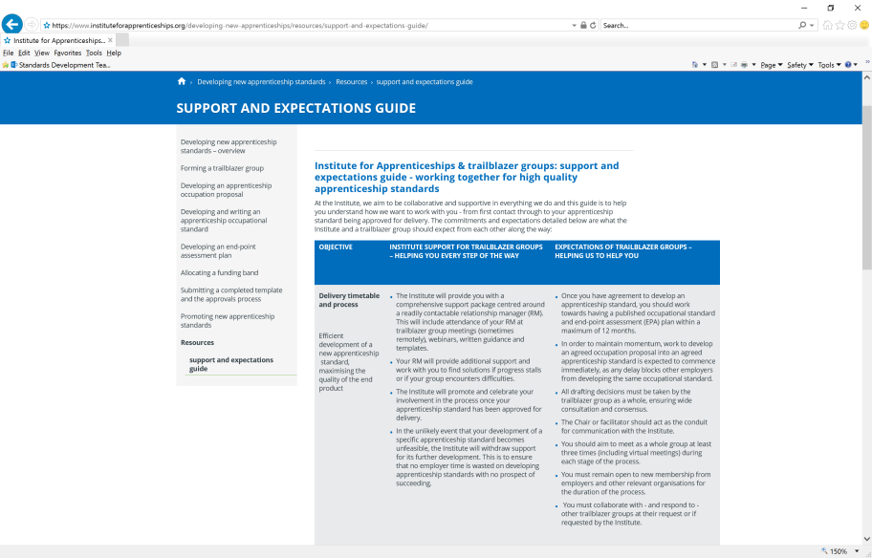
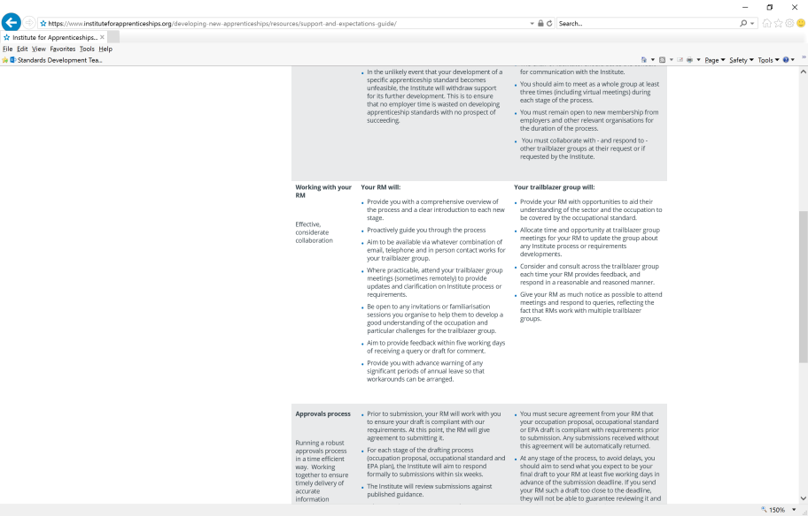
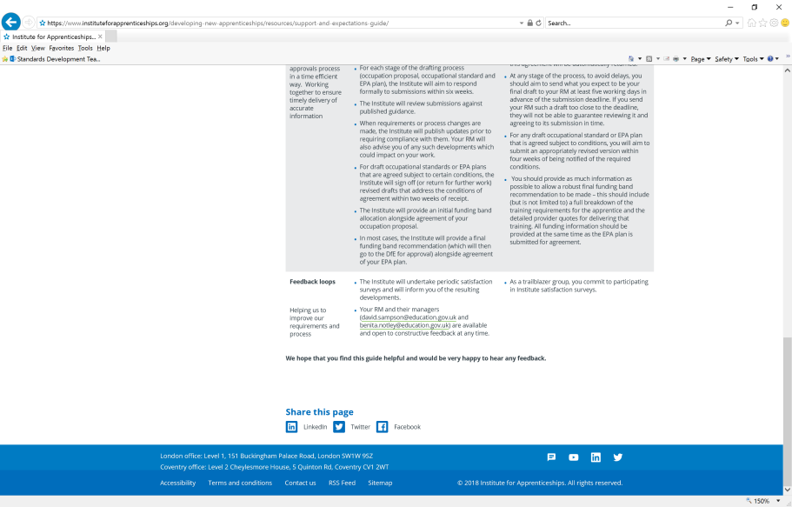

Working with the Institute for Apprenticeships
Institute support
  The relationship manager (RD) is the key contact in the Institute,
  advising on requirements,
  guiding through the development process
  accessing support

Slide 14
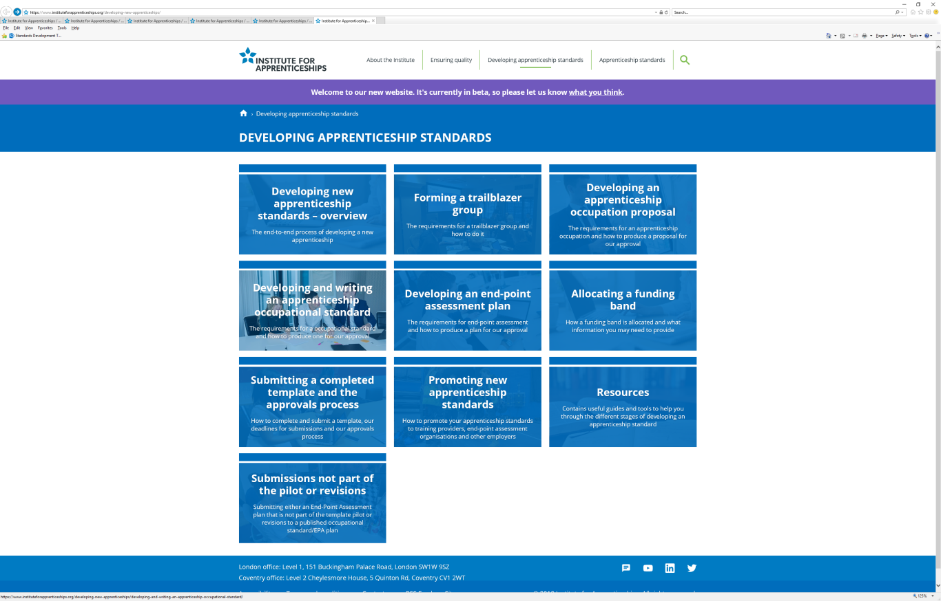
Guidance & other support
Institute support
Developing new apprenticeship standards guidance
Webinars
Intensive workshops
Videos
Travel fund for small
employers

Slide 15


Slide 16
Trailblazer group
Being part of the Trailblazer group
The Trailblazer Group is the steering group for the development of the apprenticeships.
Consists of about 12 - 15 members; approx half from the third sector, and training providers and half from employers (LAs, special schools, mainstream schools).
They commit to working inclusively and collaboratively with other employers.
The chair is an employer member picked by the group.
They will need to represent employers of the individuals that will undertake the role - and the Institute would even suggest that some of the members are actually those undertaking the role itself.
It is up the employer who they have as their representative.

Slide 17
More info..
It would involve 4 or 5 meetings over the year, either in person or virtually, the first meeting being at the DfE in London on Nov 1st.
Here is a link to the Apprenticeships website which provides the guidance for setting up a Trailblazer Group and developing an apprenticeship
https://www.instituteforapprenticeships.org/developing-new-apprenticeships

Slide 18
Developing an apprenticeship occupation proposal
The development
process
Occupation proposal
Trailblazer reflective of likely users of standard
Demand in labour market for occupation
Transferable to a range of employers & secures earning potential etc.
Is recognized by a range of employers and people practising the occupation
Sufficiently broad, deep & skilled - needs at least a year of employment & training - 20% off- the- job
Occupational profile defines full occupational competence for a new entrant
Aligns with an occupation within relevant Occupational Map
Professional registration / Regulatory alignment (if relevant)
Is at a level between 2 and 8

Slide 19
The development
process
Developing an occupational standard
Occupational Standard
Standard is short, concise & clear
Based on a clear occupational profile setting out duties undertaken by employees
Knowledge, Skills & Behaviours are derived directly from the duties
Inclusion of English & maths requirements
Defines full occupational competence from a new entrant perspective & for any employer
Confirmation of any professional / regulatory alignment
Justification for inclusion of any other qualifications
Evidence of wider consultation beyond the trailblazer group
Confirmation of occupation level

Slide 20

Approvals process
Submission
Considered by Institute officials against high level criteria and recommendation made to route panel
Reviewed by Route Panel and recommendation made to Approvals and Funding Committee
Approvals and Funding Committee make final decision.
Trailblazer group informed of decision and provided with feedback letter
Decision
Peer Review
Trailblazer develops occupation proposal, occupational standard or EPA plan
Some submissions returned if further work required
Development
Week 1-3
Week 3-5
Week 5-6

Slide 21
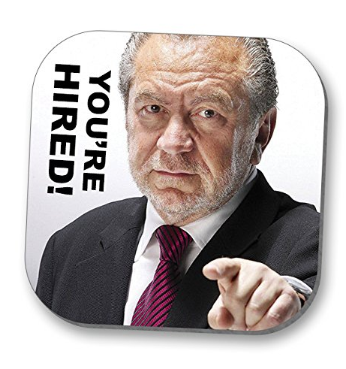

Slide 22
Think about being part of the Trailblazer group...
Thank you for your time

