Slide 1


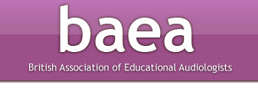
Linking Up Listening Life
The Value of Educational Audiologists
Dr Joy Rosenberg, Programme Leader MA/MSc (ToD, Ed Aud and EY courses)
Gary Webster, County Educational Audiologist, Northants
Jane North, Chair BAEA (British Association of Educational Audiologists)

Slide 2
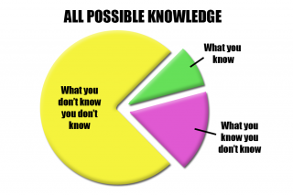

Slide 3
Session Objectives
Consider developments in resources
Consider case studies
Consider the scope of Educational Audiology Role
For the sake of ever-improving joined-up working between partners who serve children and young people who are deaf and their families
Notes:
Linking up Listening Life – Taking a holistic approach across disciplines to meet needs
This presentation considers developments in providing resources for paediatric clinicians, ToDs, Educational Audiologists and families for the sake of ever-improving
joined-up working between partners who serve children and young people who are deaf and their families; such as:

Slide 4
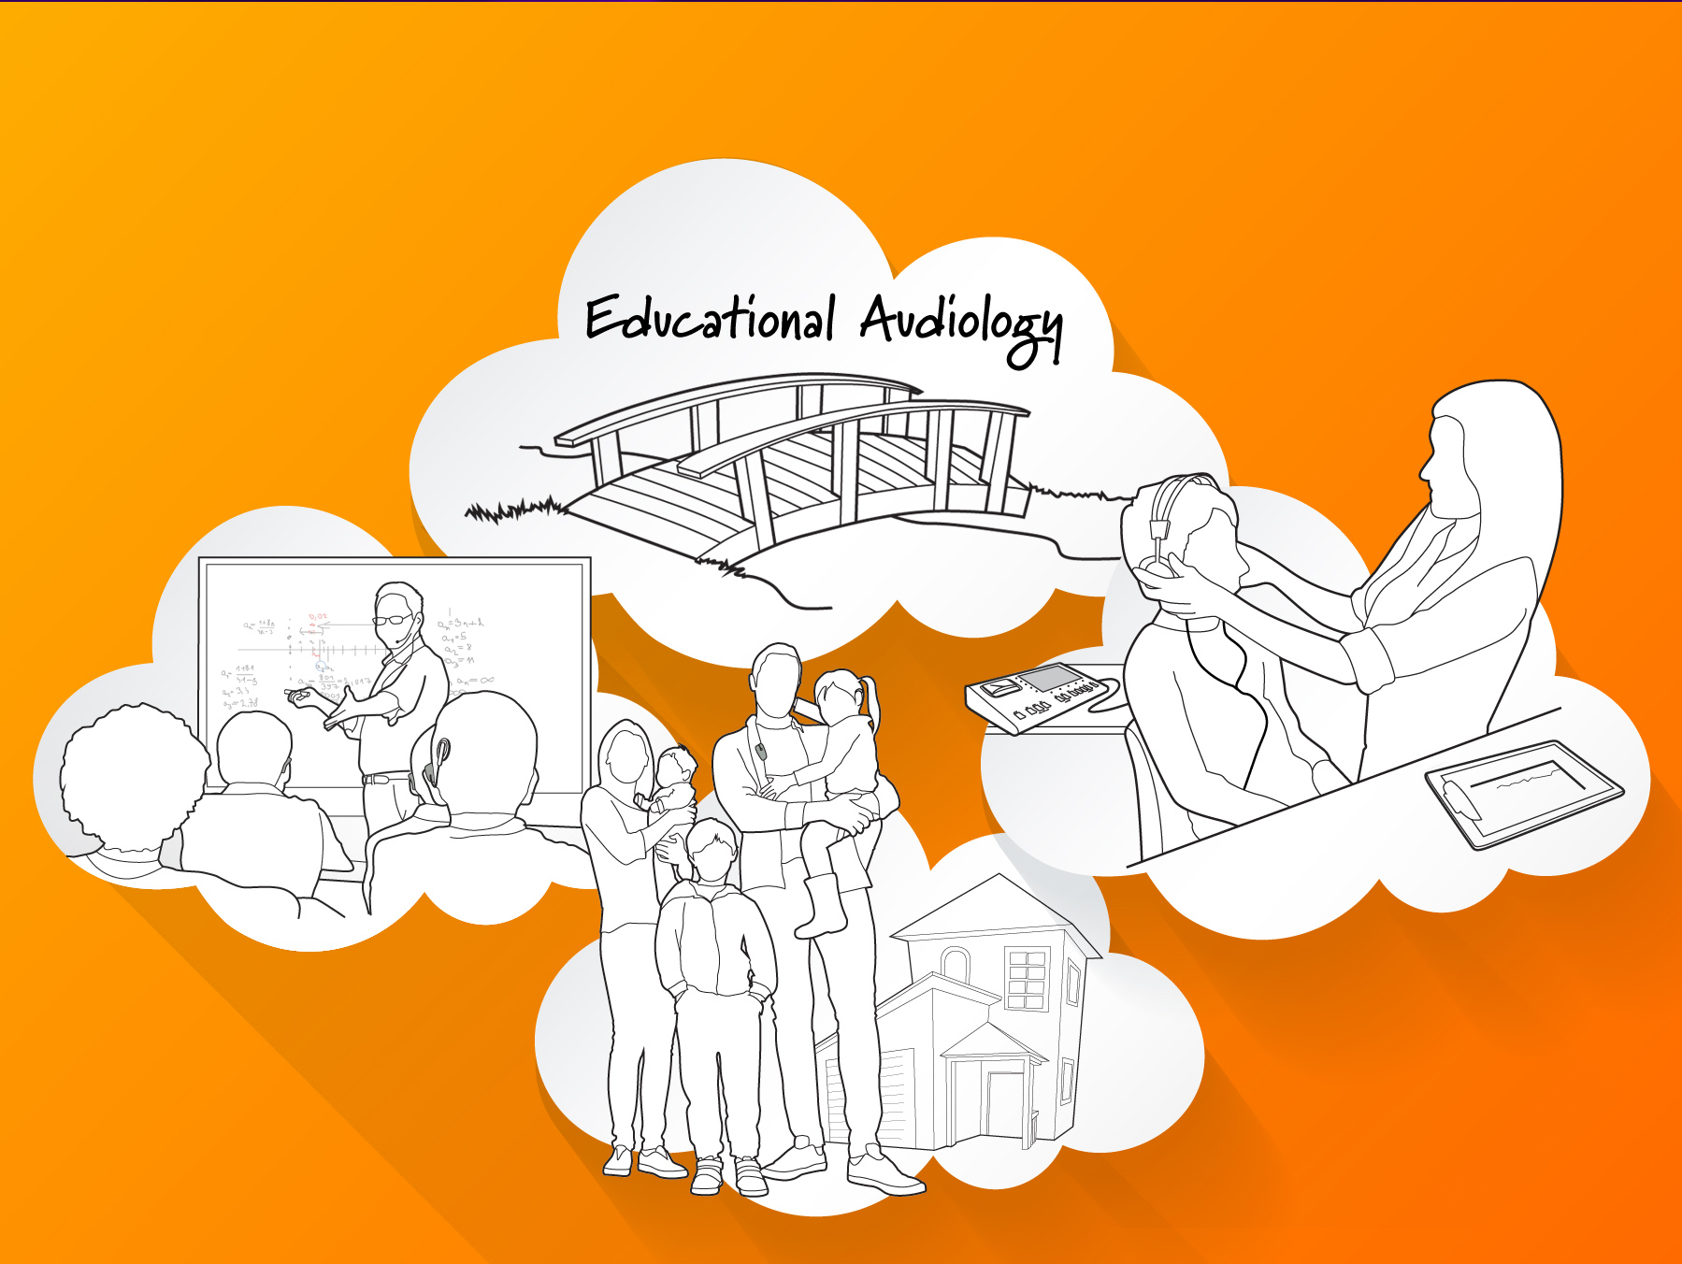
Notes:
Demonstration of the value of the Educational Audiology role as a bridge in these endeavours will be examined
Clinicians and educaitonal audiologists working together have the best opportunity to fully understand what its listening life is like outside the clinic.
enables clinicians to more readily monitor ‘real-life’ functional benefit of hearing instrument (HI) fittings when patients are outside the clinic, providing more robust validation and potentially saving clinic time.

Slide 5
New NICE Cochlear Implant Criteria
NICE - Mar 7,2019
D Vickers et al (2019) BSA presentation
  Included 2016 International Survey of CI candidacy (Cochlear Implants Interantional) and focus group votes
  Candidacy consensus included: Process to determine whether someone receives sufficient benefit from hearing aids should be revised to better assess real-world listening
Ed Auds do this every day in liaison with clinical Auds and ToDs.
Notes:
This is especially true in terms of new CI criteria.
Vickers, L. De Raeve & J. Graham (2016) International survey
of cochlear implant candidacy, Cochlear Implants International, 17:sup1, 36-41, DOI:
10.1080/14670100.2016.1155809
To link to this article: https://doi.org/10.1080/14670100.2016.1155809

Slide 6
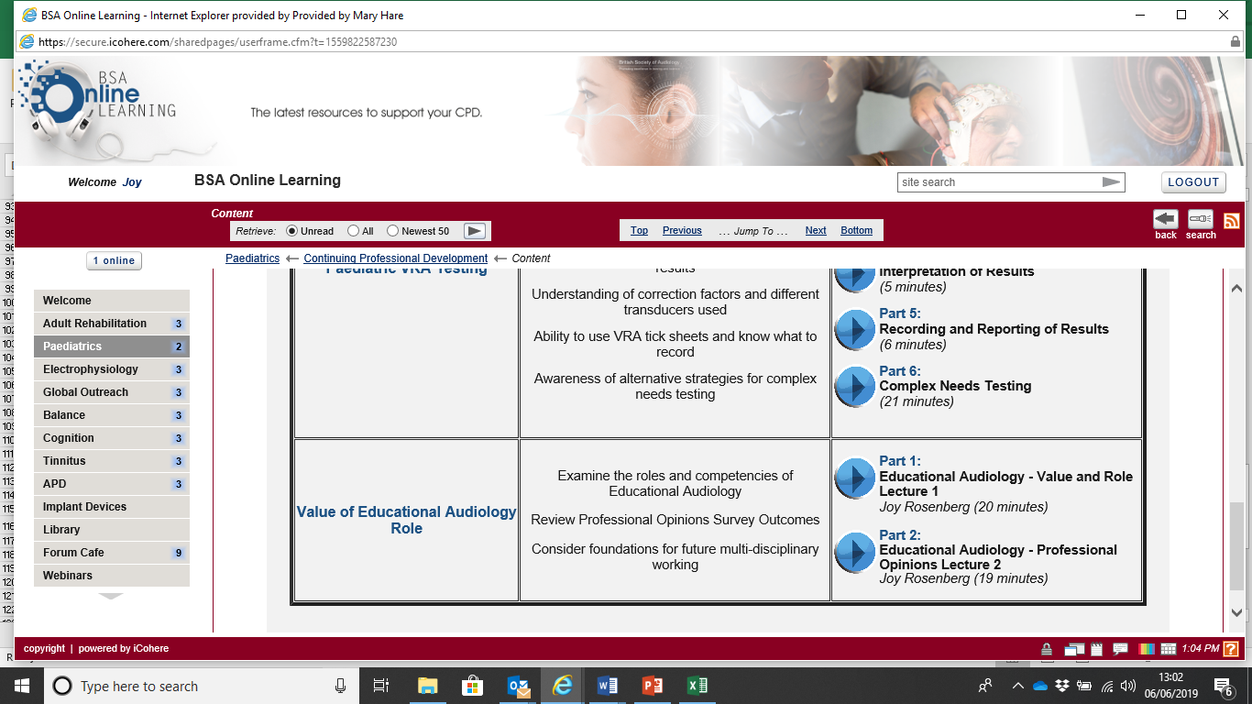
BSA Online Learning
Notes:
in terms of recent launch of new platform for e-learning modules on this topic for professional body dissemination, discussion of a nascent collaborative multi-national research project, updates on opening of professional registration, and service leadership engagement and involvement.
Early verification and validation of hearing instruments will be discussed in light of joint professional body liaison to reach mutually beneficial ends in this area, especially related to early years radio aid procurement and fitting.

Slide 7
Example slide from BSA Online Learning:
Case Study – Child A
Severe HL from birth
Developing normal phoneme production with hearing aid (HA) use in preschool years
New HAs fitted
Phoneme production deteriorated, which was unheeded by professionals, having no Ed Aud available in Local Authority
Family moved to a Local Authority that did have Ed Aud services who liaised with Health Audiology. Phoneme production deterioration was heeded and appropriate adjustments resulted in positive outcomes
Notes:
Children’s problem cases where there was no Educational Audiologist in place. These were identified when an Educational Audiologist became involved.
Child A (born with a Severe hearing loss as defined by BSA recommended procedures) had developed most phonemes including those above 4kHz in spontaneous speech by about age 5yrs. Child A was switched to ‘sound recapture’ hearing aids for no reason – the previous aids had provided hearing across the whole range of speech frequencies, hence the development of the normal phonemes. The Audiological Scientist did not work with or have access to an Educational Audiologist. After sound recapture aids the Speech & Language Therapist (S&LT) became very concerned that some speech sounds were now deteriorating, especially [s] which the child could produce correctly before. The S&LT reported that the child’s pronunciation of [s] had become more like ‘sh’. The Audiological Scientist refused to change the hearing provision in any way, even after an external assessment by an Educational Audiologist indicated that the [s] sound (learnt through aided hearing) now sounded like ‘sh’ to child A, as the sound frequencies above 4kHz had been shifted down to 3 kHz. The child was beginning to copy sounds the way s/he was hearing them, ie incorrectly.
The S&LT, the Parents (and the independent specialist Educational Audiologist assessor) were ignored by the hearing aid provider who clearly did not understand what the change in hearing aids was doing to the perception of speech for that child.
Understanding the different frequencies of speech sounds and how babies and children develop their speech by hearing them is not part of the Audiological scientist’s training but it is part of the Educational Audiologist’s training.
The only chance of getting the right hearing provision for this child is for the parents to move house to a different hospital catchment where the Audiology clinics have an Educational Audiologist from Education working with the Audiological Scientist from Health

Slide 8
Why couldn’t other professionals prevent this case study issue?
They could. If time and communication/expertise had allowed it.
But they didn’t – probably due to lack of time and communication
An Ed Aud has the remit and the expertise to provide the bridge needed, especially when that bridging is not happening otherwise

Slide 9
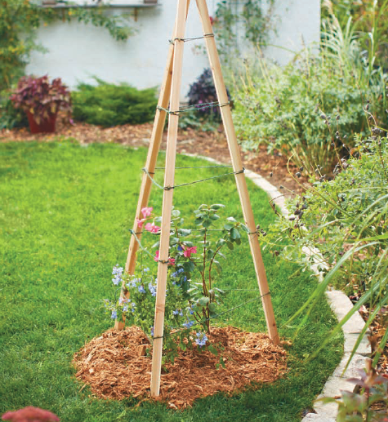
Research on LinkingUpListeningLife
Nascent
Collaborative (UK & US – Clinical and Educational Auds)
Value of Ed Aud role
Retro and Prospective student perspectives in case studies
Analysed according to Outcomes, Role and Competencies
Notes:
Early verification and validation of hearing instruments will be discussed in light of joint professional body liaison to reach mutually beneficial ends in this area, especially related to early years radio aid procurement and fitting.
Use of social media by professional bodies to inform and share best practice from various professionals linking up with one another to advance the listening life of those they serve will be exhibited.
Impact of these developments on families of children with complex needs will be explored.
Delegates will be challenged to consider the implications of these developments on their current roles and ways that improved joined-up working in their areas can benefit linking up listening life for the children and young people served.

Slide 10
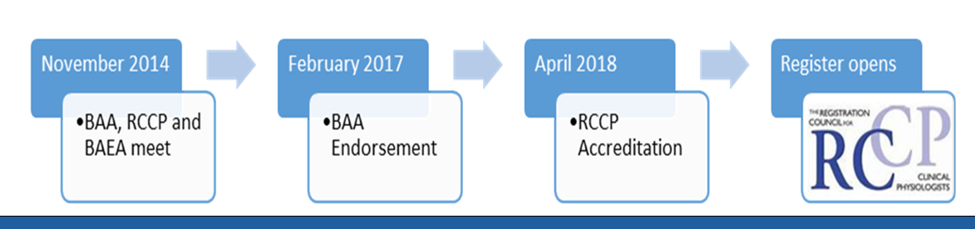
Professional Registration
Update – 1st registrations now processed
Service leadership engagement and involvement
Process
Notes:
in terms of recent e-learning modules on this topic for professional body dissemination, discussion of a nascent collaborative multi-national research project, updates on opening of professional registration, and service leadership engagement and involvement.
Early verification and validation of hearing instruments will be discussed in light of joint professional body liaison to reach mutually beneficial ends in this area, especially related to early years radio aid procurement and fitting.
Use of social media by professional bodies to inform and share best practice from various professionals linking up with one another to advance the listening life of those they serve will be exhibited.
Impact of these developments on families of children with complex needs will be explored.
Delegates will be challenged to consider the implications of these developments on their current roles and ways that improved joined-up working in their areas can benefit linking up listening life for the children and young people served.

Slide 11
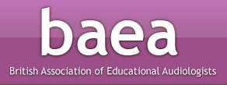
Campaigns - BAEA
BAEA letter writing
Early verification and validation of hearing instruments will be discussed in light of joint professional body liaison to reach mutually beneficial ends in this area, especially related to early years radio aid procurement and fitting
NDCS, RA Wrkng Grp – other connections

Slide 12
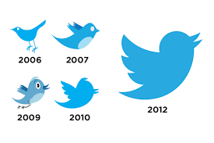
Social Media - PAIG
PAIG twitter
Use of social media by professional bodies to inform and share best practice from various professionals linking up with one another to advance the listening life of those they serve will be exhibited.

Slide 13
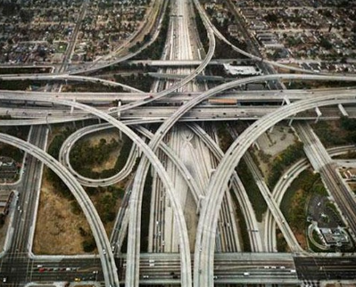
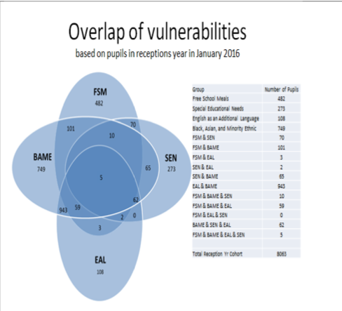

Bridge is adaptable as complexities increase….
Notes:
Not only that, but I am adaptable as the bridging has become more complex
Blue graphic from: OxCC Strategic Overview 2016-2020 for Vulnerable Learners – SEN is only one part intersecting with the others.

Slide 14
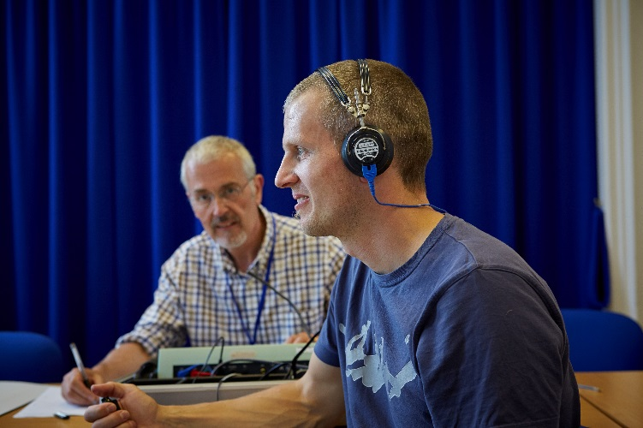
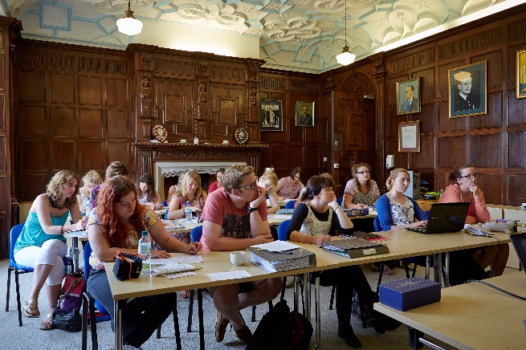
Training Developments
Stand-alone postgrad modules
Uptake for clinicians or ToDs
Topics include
  Communication Speech and Language Development
  Pychoacoustics
  Family Friendly Multi-Agency Working
  Whole Case Management
  Speech Acoustics
  Clinical Audiology
  Ed Aud in Practice
  Anatomy, Physiology and Pathology
https://www.maryhare.org.uk/professional-courses/postgraduate-courses

Slide 15
Gary Webster,
County Educational Audiologist, Northants.
Example-1 = AAZ
Example-2 = ADJ
Example-3 = AYK
NB: Initials are pseudonyms

Slide 16
AAZ
Query: mother wants radio aid asap. TOD in agreement.
Bilateral implantee @ 12 months
  CA = 2 years 7 months
  No apparent complex needs
FM Readiness kit :
  Family training.
  Empowerment.
  Evidence gathering for funding request.
  Working collaboratively with EY TOD.
  AIC views.

Slide 17
ADJ
Query: Not developing his attentive listening skills in the classroom.
Background:
  Home.
  Bilateral implantee from 2 years of age.
  Reliable processor user.
  Poor school appreciation.
Radio aids – strength + weaknesses.
Supplementary Soundfield system in conjunction with Radio Aid.
Working collaboratively with TOD.

Slide 18
AYK
Query: does this child need sign language?
Background:
  Very late implantee.
  Had ACSW for many years.
  Not signing back.
  Not signing in the home.
Assessments/evidence gathering:
  TAPS
  SIQ/SIN
  Working collaboratively with TOD+Family.

Slide 19
The scope of an Educational Audiologist
Jane North
Educational Audiologist (RCCP Registered)

Slide 20
Outcomes:
Importance of Acoustics
Supporting parents understanding of equipment
NHS Paediatric Clinics

Slide 21
Supporting Listening in School supports Learning
The ambient noise (that is without anyone in the room and just the noise of heating and anything that might be running), averaged at 53.6dB, exceeding the standard 35dB required for normal classrooms.
A weighting = simulated normal ear
Frequency (Hz) | Measurement 1 (middle) | Measurement 2 (right of the hatch) | Measurement 3 (left of the entrance door) | Average measurement per second
125 | 4.04 | 2.68 | 2.00 | 2.90
250 | 2.84 | 3.20 | 2.97 | 3.00
500 | 3.58 | 3.41 | 1.79 | 2.93
1000 | 3.61 | 3.04 | 3.44 | 3.36
2000 | 2.92 | 1.75 | 2.99 | 2.55
4000 | 2.15 | 1.81 | 1.71 | 1.89
A Average | 3.19 | 2.64 | 2.48
Buildings bulletin 93 (BB93) Explains minimum performance standards for acoustics of school buildings (updated 19th December 2014)
recommended <0.6 m/seconds or for children with a hearing loss <0.4 m/seconds.
https://www.gov.uk/government/publications/bb93-acoustic-design-of-schools-performance-standards

Slide 22
Results explained
Each frequency takes at least 5 times longer to decay than the reverberation levels significantly exceed those recommended BB93
This situations damages listening and learning because:
listening in this environment is very difficult and stressful, for all children and staff.
The clarity is speech is so poor that is more likely to confuse students and increase noise induced hearing sensitivity.
Children will be tired as they are concentrating on listening and may not be processing information.
Primary children need clarity and time to process the information without the interference of the echoing effect of reverberation.
The two most important areas to reduce reverberation are the ceiling and the floor; however, as this is a hall, acoustic boards will need to be placed on the walls and an acoustic ceiling installed. Unfortunately for this space there is no cheaper alternative.

Slide 23
What we did
Distributed report as soon as possible because of the health implications to staff and students
Applied for funding to install an acoustic ceiling in the hall
Funding achieved and the ceiling was installed over the summer holidays.
Visited school Tested Reported Funding signed off Ceiling installed
2nd week Feb March 2019 13th March July 2019 August 2019

Slide 24
Radio Aid Clinics
Check hearing aids and troubleshoot problems – advise on care
Consider each case individually and provide Radio Aid System when appropriate
Balance all systems using the Aurical Hit Audiometer to match hearing aid prescription – meeting NDCS guidelines
Verify Radio Aid setting by Speech in Noise testing
Show parent using visual simulations and encourage parents to listen to their child Hearing Aid/CI processor through the Radio Aid System.

Slide 25
Supporting NHS Audiology Clinics
Educational Audiologists support NHS Paeds Clinics and vice versa
Example:
Discuss case with Clinical Audiologist raising concerns
After testing and hearing aids reprogramming tested using LING sounds
Results:
Slight increase of frequencies 4kHz and 8kHz
– child was able to reproduce all LING sounds therefore better access all spoken language supporting listening and learning.

Slide 26
Challenges to discuss in small groups
Choose a development or role aspect as discussed to consider the implications in your service.
In what ways can improved joined-up working in your local area benefit linking up listening life for the children and young people served?
What are some improvement possibilities? What are barriers? What are options for overcoming?

Slide 27
Overall Session Objectives Revisited
Consider developments in resources
Consider case studies
Consider the scope of Educational Audiology Role
For the sake of ever-improving joined-up working between partners who serve children and young people who are deaf and their families
Notes:
Linking up Listening Life – Taking a holistic approach across disciplines to meet needs
This presentation considers developments in providing resources for paediatric clinicians, ToDs, Educational Audiologists and families for the sake of ever-improving
joined-up working between partners who serve children and young people who are deaf and their families; such as:

Slide 29


