Slide 1
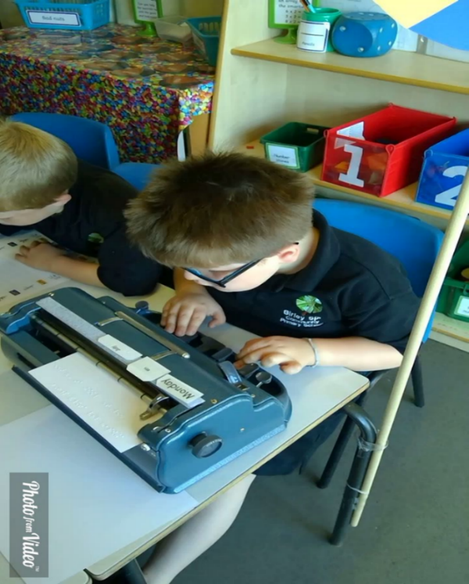
Evidencing impact of QTVI Intervention
Sheffield Vision Support Service

Slide 2
VI Specialist Curriculum
How do VI specialist skills relate to mainstream measures?
How can we quantify what QTVI teaching achieves, and what student outcomes are a direct result of this?
How do we take into account the unique learning needs of severely sight impaired students whilst still working towards mainstream curriculum outcomes?
Notes:
AS VI TEACHER AND SERVICE MANAGAGER THERE IS A CONTINUAL QUESTIONING AROUND WHAT IMPACT WE HAVE ON STUDENT PROGRESS / As well as independence skills such as mobility the specialist curriculum involves
Specialist ICT, Braille literacy, tactile skills in particular to access Maths curriculum. We aren’t just teachers of touch typing! These skills need explicit teaching by a specialist in teaching children with VI
IN GROUPS DISCUSS HOW YOU MEASURE STUDENT OUTCOMES THAT RELATE TO SPECIALIST SKILLS

Slide 3
Sheffield Small Steps Assessment
Map small steps of progress for non sighted students across to national curriculum descriptors.
Provides common language to discuss progress with mainstream staff.
Framework to set smart targets and measurable achievable outcomes
Provides accurate measurable information on individual pupil progress and service impact.
Termly summative assessment of intervention teaching linked to curriculum and specialist skills learning.
Numerical values show progress towards independence and mastery of curriculum and specialist skill.
Notes:
As QTVI always found that it was difficult to get mainstream teachers to understand the complexity and depth of skills that need to be explicitly taught to non sighted students.
Map across to NC – if you take just one NC descriptor even this can seem unachievable for blind student – so we have broken each descriptor down into small steps.
COMMON LANGUAGE – shared understanding of what pre and post teaching is needed to access the learning in mainstream classroom
MEASURABLE OUTCOMES – Very difficult to measure progress of a regional or national cohort of severey sighted students as the cohort is so small and rarely is there just a single disability
The assessement was devised to map … which shows the steps of learning towards an individual area of learning in national curriculum. All specialist
skills linked learning cannot be taught or used in iscolation of curriculum.
Provides common language … explain process of meetings with mainstream teacher to assess overall level and inform planning of intervention teaching
Progress and impact – important that we as services can demonstrate impact by measuring progress of intervention teaching through outcomes and small steps related we can show how our teaching enabled success in areas of curriculum which otherwise would have been inaccessible to the student

Slide 4
Assessment Purpose
Use to assess and identify areas of weakness with class teacher.
Can be used to plan and measure curriculum interventions by Vision Support team.
Can be used to assess individual student progress and impact of support.
This assessment can be used to directly feed into setting outcomes for my plans/EHCP’s and evidencing progress.
SEND Termly review meetings – Ensures small step progress is recorded even if whole outocme not achieved.
Accurate summative assessment – Helps plan next steps.
Notes:
Although assessment talks about year groups it doesn’t mean you have to assess against year they are in just what age they are working at academically … so a child in Y5 might be working at Y2 level and this is ok
Equally you may have a KS3 student in Y8 who is working at primary phase Y5 level.

Slide 5
Maths Statistics Year 1-6
Statistics -can solve comparison, sum and difference problems using information presented in a line graph. | can track x and y axis on graphs to identify number scales
 | can identify number jumps on scales ie. 2's 10's 100's
 | can find specific point on x and y axis
 | can track up the bar or to point on graph then track left to identify point on Y axis
 | can interpret position found on graph to answer comparison question
 | can interpret position found on graph to answer difference question
Notes:
Maths steps allow progress to be recorded for skills that may take a significant amount of teaching time to achieve a small step. Eg tracking to a point on graph and ten tracking back to point on axis can be very difficult for non sighted child so the assessment enables levels of independence to be recorded as well as mastery of skill.

Slide 6
Writing and SPAG - Year 1-6
Continues to apply phonic knowledge and skills as the route to decoding words until automatic decoding has become embedded and reading is fluent. | Can identify individual phonemes in Braille within a word
 | decode additional contraction and identify phoneme within a contraction within a word (ar, of, for, and, st, wh, the)
 | can blend phonemes within the word to read the word in isolation
 | can blend phonemes within word that has contraction even if the contraction is not contained within the phoneme - ie other using 'the' contraction
 | can read the word within a sentence
Notes:
Explain that whilst we have put suggestions in the small steps about contracted braille teaching we understand that different authorities may have different approaches to teaching braille literacy so they are just suggestions about when contracted braille may be introduced.
All steps can be modified to suit individual learners .

Slide 7
Foundation Stage – Writing 40-60 months
Gives meaning to marks they make as they draw, write and paint. | Identify the parts and functions of the Braille Writer.
 | Put paper into the Braille Writer and lock it into place.
 | Remove paper from Braille Writer in the correct way.
 | Associate the position of the dots on paper with the keys punched.
 | Demonstrate correct positioning of hands on keys of Braille Machine e.g left hand for keys 1,2,3 and right hand for keys 4,5,6
 | Press one key at a time with appropriate fingers
 | Demonstrate sufficient finger strength to press the keys hard enough to produce the Braille dots.
 | Demonstrate use of thumbs (one or both) to press the space bar.
 | Keep both hands in position with fingers hovering over keys when not in use
 | Demonstrate use of back spacer by use of the little finger of the right hand to press the back spacer.
 | Mark makes using a Braille Writer and feels the Braille they have produced.
 | Ascribes meaning to the Braille marks they have made.
 | Makes marks in Braille as part of role - play situations.
Notes:
For non sighted child to achieve this outcome they have to learn a number of skills unique to them.

Slide 8
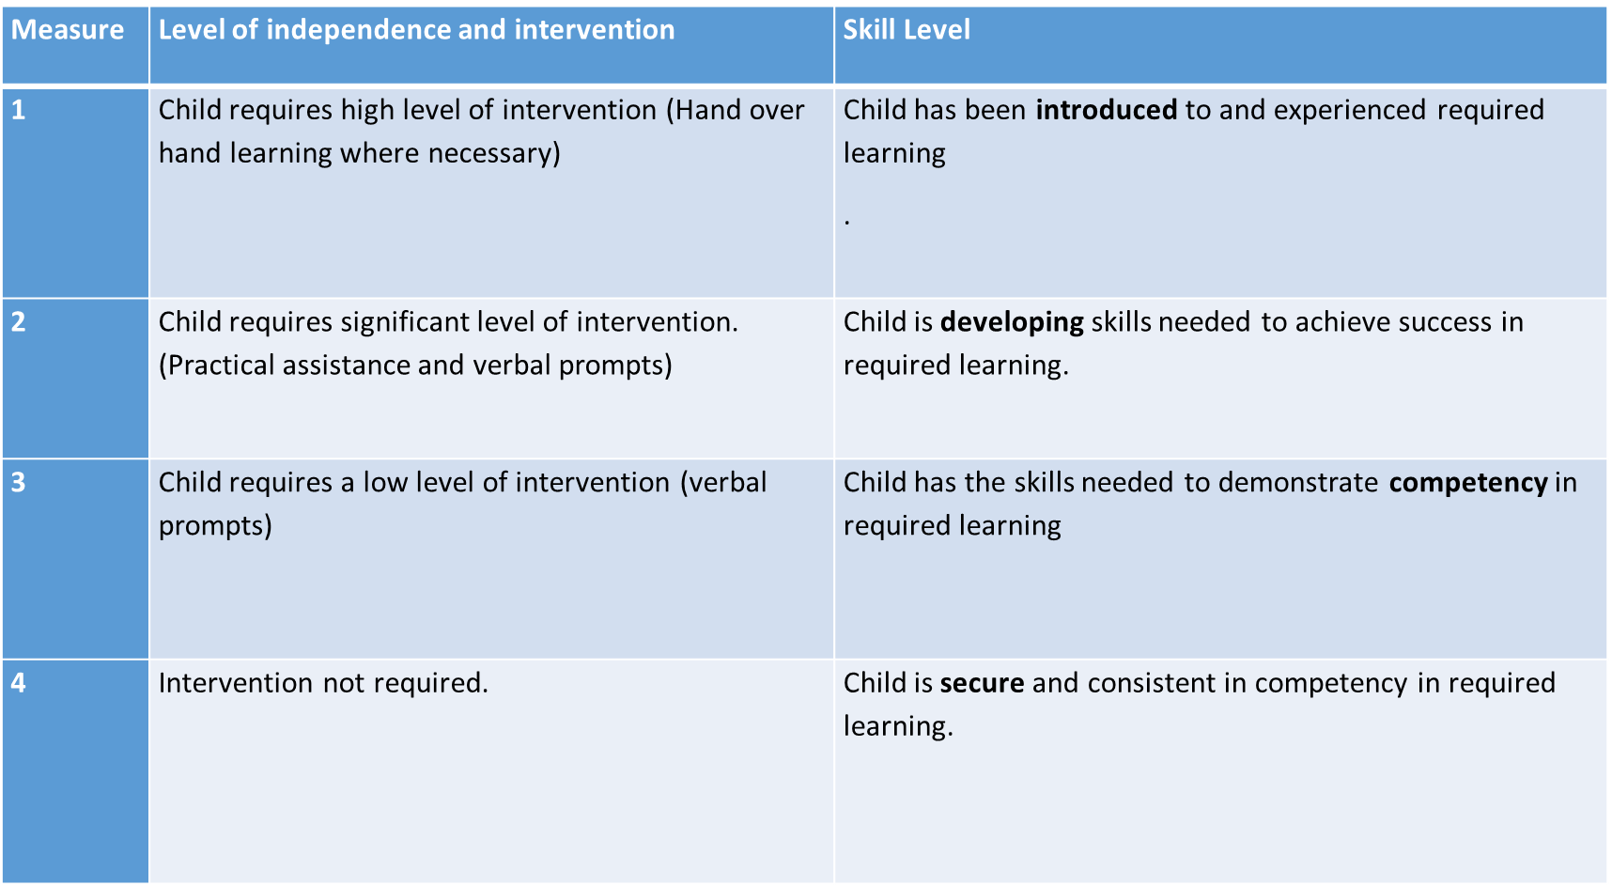
Measuring of progress and levels of independence
Notes:
Refer back to levels of independence in maths steps which is a key part of teaching as mastery of skills. It also makes adults supporting the student think about strategies to promote independent learning in all curriculum tasks – not over reliance on adult intervention.

Slide 9
Termly Summative assessment
Read aloud accurately books that are consistent with their developing phonic knowledge and that do not require them to use other strategies to work out words. | Sound out and blend letters in unfamiliar words. | 2 | 4 | 4
 | Group sounds within words to blend when reading | 2 | 3 | 4
 | Identify letters in familiar words and start to read without having to speak each letter using anchor letters to Reads word. | 1 | 2 | 4
 | Read each letter in word in head then read full word without sounding out. | 0 | 2 | 3
 | Once familiar with text predict words without reading every letter in each word. | 0 | 1 | 2
 | Reads punctuation within the text | 1 | 2 | 3
Notes:
As shown previously the number score can be done half termly or termly and can form part of termly outcomes planning linked to my plan or EHCP
The number reflects Mastery and levels of independence in achieving each small step.
Over time the workbook shows what intervention has taken place over the year which has contributed to over all NC subject progress.
This could be used to measure progress in small group, one to one teaching or show impact of in class support with focus on a specific area of development.

Slide 10
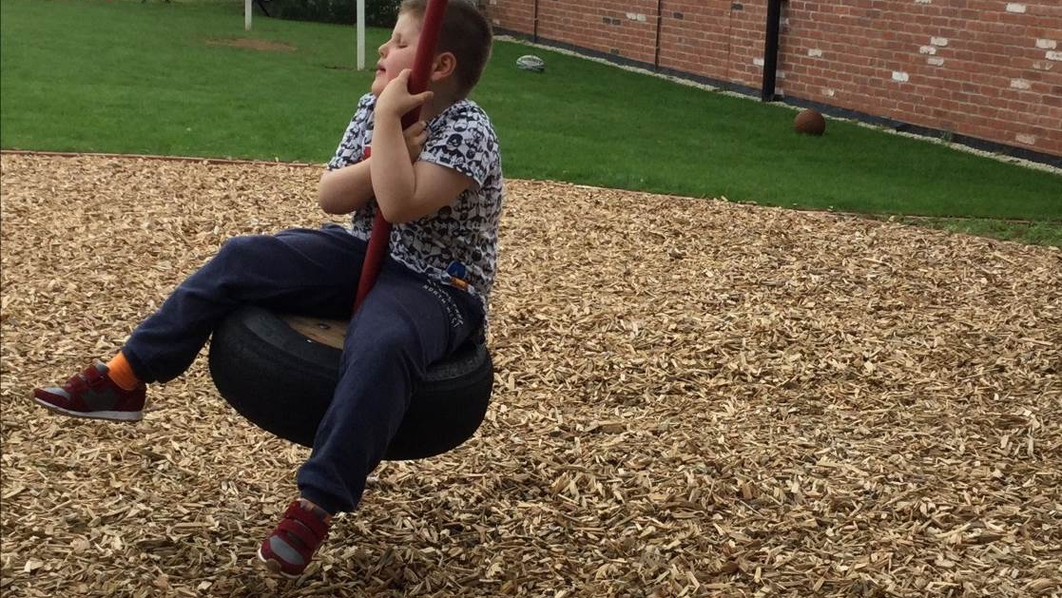
Kieran
Y3

Slide 11
Kieran – Congenitally Blind and Diagnosed Autism
Kieran is meeting all age-related expectations in core curriculum areas and exceeding them in maths-however, his autism means it can be quite difficult for him to follow routines and conform to classroom rules at times.
Kieran requires a curriculum that is additional to and different from the Y3 curriculum with regards to teaching of specific Braille literacy skills to achieve the age related outcomes for Y3 within the National curriculum. These are planned and taught through VSS interventions in line with the small steps.

Slide 12

Planning
At the half termly meeting new curriculum topics to be taught are discussed with class teacher, and areas of the specialist curriculum that are needed to access the learning are identified.
Topic for intervention teaching is identified based on class teacher planning. This is taught for as long as Kieran needs, in order to develop his independent working skills.
Sometimes the small steps will need modification to suit individual learners.

Slide 13
Termly Assessment
Kieran’s specialist interventions are assessed termly. This feeds into the overall school assessments of a pupil and his EHCP outcomes. There is no expectation that Kieran will achieve the intervention outcome by the end of the term (but it’s nice if he does!).
To do the assessment a score 1-4 is given for each small step according to his level of independent achievement. The attainment can then be graphed which allows you to see which areas still need further work, which in turn informs future planning.

Slide 14
NC Descriptors Maths Year 3 | Small Steps | Autumn 2 | Spring 2 | Summer 1
Addition & Subtraction can add and subtract numbers with up to three digits, using formal written methods of columnar addition and subtraction. | partition numbers with hundreds tens and ones | 4
 | understands that the lay out of + and - in column format is different | 4
 | Can read an addition or subtraction calculation set up in braille column format | 3
 | understands what each digit represents tens, ones etc. | 4
 | braille the column calculation using spacing on Perkins to line up each number in correct place | 3
 | braille answer from braille column sum in correct place | 3
 | read the numbers from ones to tens to hundreds and beyond and solve the calculation | 4
 | solves calculations that do not cross the tens hundreds etc barrier | 4
 | understands that in subtraction if the number is too big then they can "borrow" | 2
 | understands that in addition if the number crosses the tens or hundreds etc. barrier they can carry over | 2
 | Uses a tactile marker to represent carrying over in addition calculations | 1
 | uses a tactile marker to represent borrowing in subtraction calculations | 1
 | calculates the answers to addition and subtraction calculations that involve crossing the hundreds/tens/ones barriers | 2
 | Braille the answers correctly within the calculation | 2

Slide 15
Termly Summative Assessment
Notes:
Allows all to see if which steps have been achieved and which need to be carried over to achieve larger outcome.

Slide 16
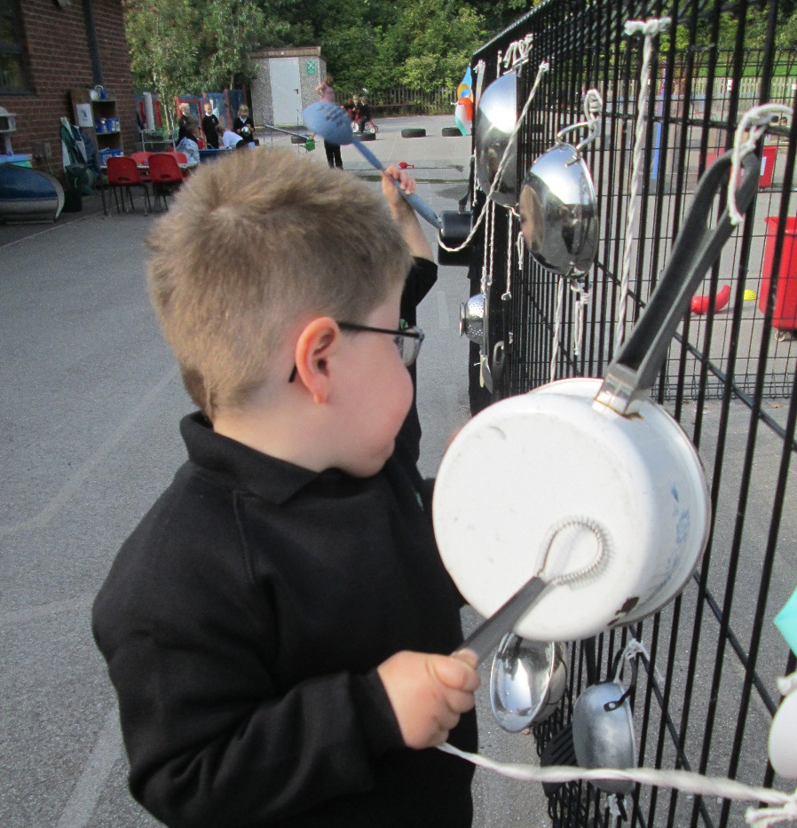
Reporting
At the end of each term a progress report for Kieran is produced.
Kieran’s self assessment is added to the report, so the voice of the child is heard.
A copy of the report is given to parents and school.
This allows parents and school to see progress made from intervention teaching and also how this relates to the curriculum.
Notes:
At the end of each term I write a progress report for Kieran. This talks specifically about intervention planning and generally about progress within the curriculum. Kieran’s self assessment is added to the report so the voice of the child is heard.
A copy of the report is given to parents and we meet informally to discuss their feedback. See pack for examples of planning and summative assessment

Slide 17
Intervention teaching from QTVI.
Discuss a high needs child in your service – what interventions do they have from QTVI
How do these interventions relate to curriculum
What other specialist skills do they need to develop could they be presented in this way?
Notes:
Introduce task – mention different ways of working ie. QTVI delivering intervention or QTVI providing programme of work for TA in school and overseeing.
If time have discuss Get feedback from colleagues

Slide 18
EHCP’s and termly reviews
In the format of small steps assessment we create outcomes for each year that link into the wider outcomes in the EHCP. These are tracked termly assessing progress of each small steps working towards the outcome (see outcomes sheet in pack).
The tracking is repeated at the end of each term and evaluated to see if the outcome has been achieved.
If it has not been achieved the outcome is retained small steps that have been achieved can be removed and additional ones added if needed.
Notes:
This academic small steps can be pasted into the document but also any additional outcomes written and recorded in the same way. This allows outcomes to be smart as each small step is measured for stage of progress.

