Slide 1
Education inspection framework 2019:
Inspecting the substance of education
Nick Whittaker HMI, Specialist Adviser SEND

Slide 2
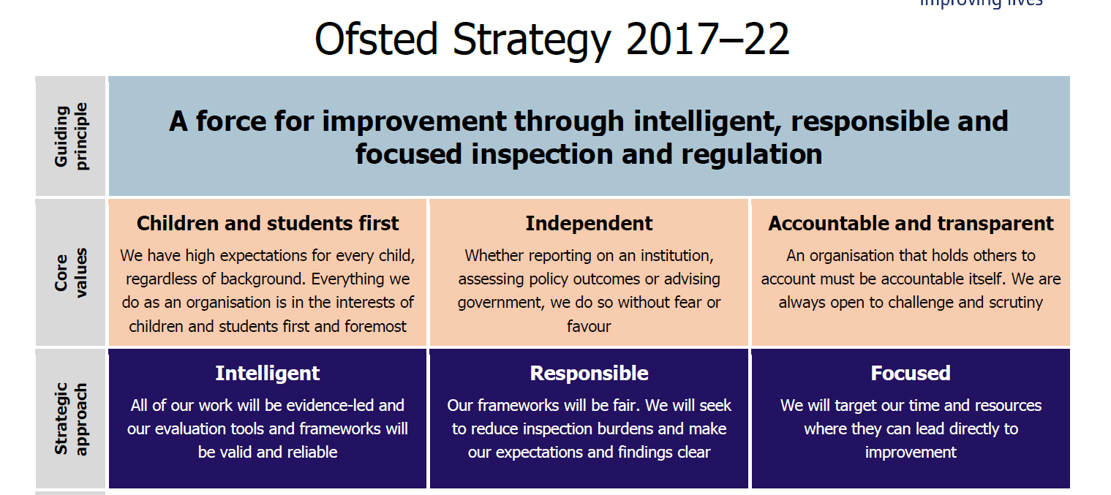
Ofsted’s five-year strategy:
The new framework is based on a solid evidence base relating to educational effectiveness and valid inspection practice.
We continue to be clear about our expectations and fight misconceptions.
We have removed any measures that do not genuinely assess quality of education and training. We will prioritise weaker provision and observe more outstanding practice.

Slide 3
The EIF judgement areas:
Overall effectiveness
Overall effectiveness
Teaching, learning and assessment
Quality of education
Outcomes
Behaviour and attitudes
Personal development, behaviour and welfare
Personal development
Leadership and management
Leadership and management

Slide 4

EIF and Inclusion:
Schools should have an inclusive culture that supports arrangements to identify early those pupils who may be disadvantaged or have additional needs or barriers to learning.
Inspectors will take a rounded view of the quality of education that a school provides to all its pupils, including disadvantaged pupils, the most able pupils and pupils with SEND.

Slide 5

Components and composites:
Components are the building blocks that together, when known, enable successful performance of a complex task.
Composites are tasks that require several building blocks or components.
Knowledge deficits accumulate when ‘layered’ on top of one another in a curriculum sequence. This accumulation of gaps limits and may even prevent acquisition of complex skills that depend on them. This is called cumulative dysfluency.

Slide 6
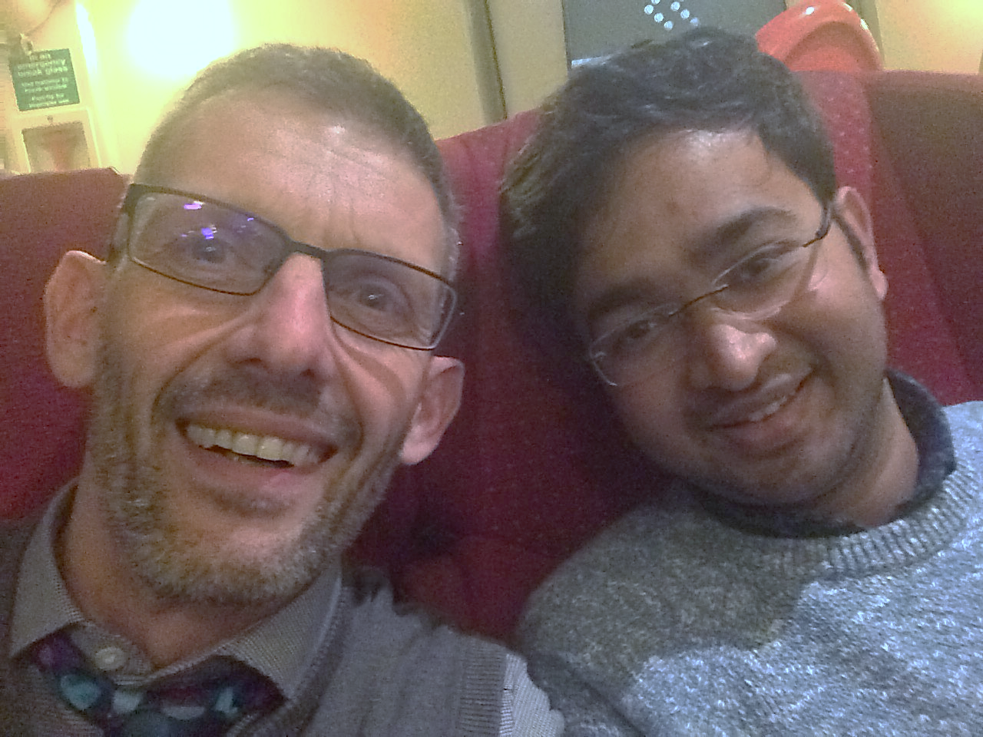

Slide 7
Quality of education and curriculum:
The knowledge and skills that pupils will gain at each stage ‘intent’.
The way that the curriculum developed or adopted by the school is taught and assessed in order to support pupils to build their knowledge and to apply that knowledge as skills ‘implementation’.
The outcomes that pupils achieve as a result of the education they have received ‘impact’.
Quality of education

Slide 8
Applying the EIF in schools:
Inspectors will gather and evaluate evidence about:
Whether leaders are ambitious for all pupils with SEND
How successfully leaders involve parents, carers and, as necessary, other professionals/specialist services in deciding how best to support pupils
How well leaders develop and adapt the curriculum so that it is coherently sequenced to all pupils’ needs, starting points and aspirations
How well the learning and development of pupils with SEND are assessed and whether their outcomes are improving.

Slide 9

Inspecting the curriculum:
A top-level view about the school’s curriculum, exploring what is on offer, to whom and when, and why these choices were made.
A deep dive, gathering evidence on curriculum intent, implementation and impact in a sample of subjects or ‘curricular units’.
Bringing evidence together and planning day 2 inspection activities to test whether the features of the quality of education identified in deep dives are systemic.

Slide 10
A continued sharp focus on safeguarding:
Our inspection of safeguarding will continue to be built around three core areas.
  Identify: how do leaders and other staff identify learners who may need early help or who are at risk of abuse?
  Help: what timely action do staff take to ensure that learners get the right support when they need it, including preventative work, and how well do they work with other agencies?
  Manage: how do responsible bodies and staff manage their statutory responsibilities and, in particular, how do they manage safe recruitment and respond to allegations about staff/other adults?

Slide 11

Changes to section 8
Inspectors will focus primarily on the quality of education during a section 8 inspection of a good or non-exempt outstanding school.
Inspectors will consider key factors relating to pupils’ behaviour, gaming and off-rolling, pupils’ wider development and workload.
Inspectors will always make a written judgement in the report about whether the arrangements for safeguarding pupils are effective.

Slide 12

‘Social justice requires that we provide an education which gives the less privileged access to the knowledge they need to succeed’.

Slide 13




Ofsted on the web and on social media
www.gov.uk/ofsted
https://reports.ofsted.gov.uk
  www.linkedin.com/company/ofsted
  www.youtube.com/ofstednews
  www.slideshare.net/ofstednews
  www.twitter.com/ofstednews

