Slide 1
Case study
Mid teens
Diagnosis of MSI
Cerebral Visual Impairment (CVI) – unable to see photo’s, symbols or screens (2d)
Auditory Processing Disorder
Social & Communication Difficulties
Main form of communication:
Objects of Reference for receptive & expressive communication
Repertoire of 2 signs

Slide 2
What could support his communication?
What would you assess? How?

Slide 3
Case study
Age 6
Coloboma in both left and right eyes
Profound hearing loss due to absent auditory nerve
Started to walk at age 5/6
Appears to understand some symbols
Can navigate youtube
Main form of communication:
Gesture and behaviour

Slide 4
What could support his communication?
What would you assess? How?

Slide 5
Case study
Age 17
No useful vision, only light perception
Profound hearing loss but can access sound when aided
Communication in place:
Objects of Reference
Hand under hand signing
Appears to respond to some spoken words

Slide 6
What could support his communication?
What would you assess? How?

Slide 7
Case study
16 years old
Degenerative condition that affects vision and hearing.
Profound hearing loss, refuses aids
Visual impairment that could deteriorate over time
Tactile defensive
Main form of communication:
Picture Exchange Communication System (PECS)
Visual schedules

Slide 8
What could support his communication?
What would you assess? How?

Slide 9
Case Study
15 year old young man with Wolframs Syndrome
Profound Hearing Loss, with Hearing Aid on Left Side only
Severe Vision Impairment
  Recent deterioration to 1/60
Attends Mainstream School
Sitting GCSE exams in core subjects next summer
Large print and speech user until recent deterioration in vision

Slide 10
Case Study
To provide student with a range of tools and skills to improve access to learning and independence.
To provide short term access strategies to enable access to exams.
To provide short term strategies to aid transition to college.
Notes:
APPS
iPad
QR codes

Slide 11
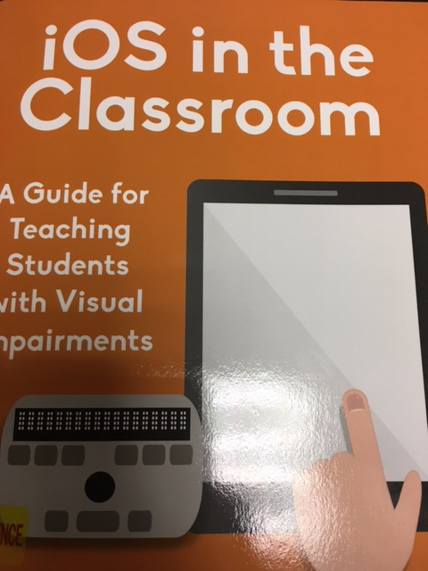
Inbuilt features:
  Voiceover
  Zoom
  Magnifier
  Display
  Facetime
  Photos, Camera, Video
  Bluetooth
  Calculator

Slide 12
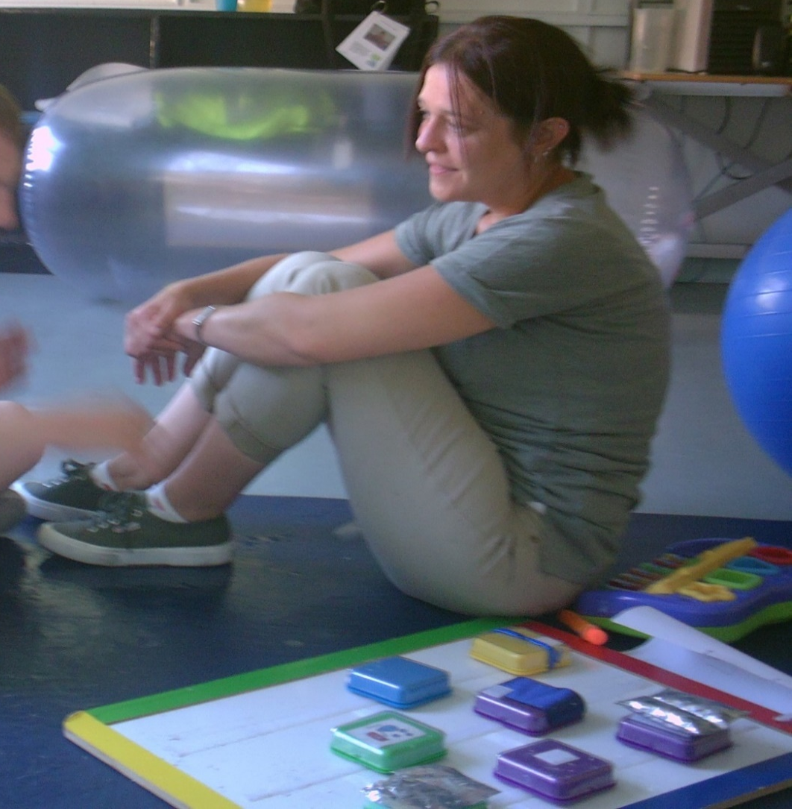
Talking board

Slide 13
Talking board
Textured switches
Switches added through Intensive Interaction/Developing interests
Gradually moved board further away giving a verbal prompt ‘choose’
Quickly started to problem solve, when water spray ran out, he would find board and press’water spray’ and pass empty bottle.

Slide 14
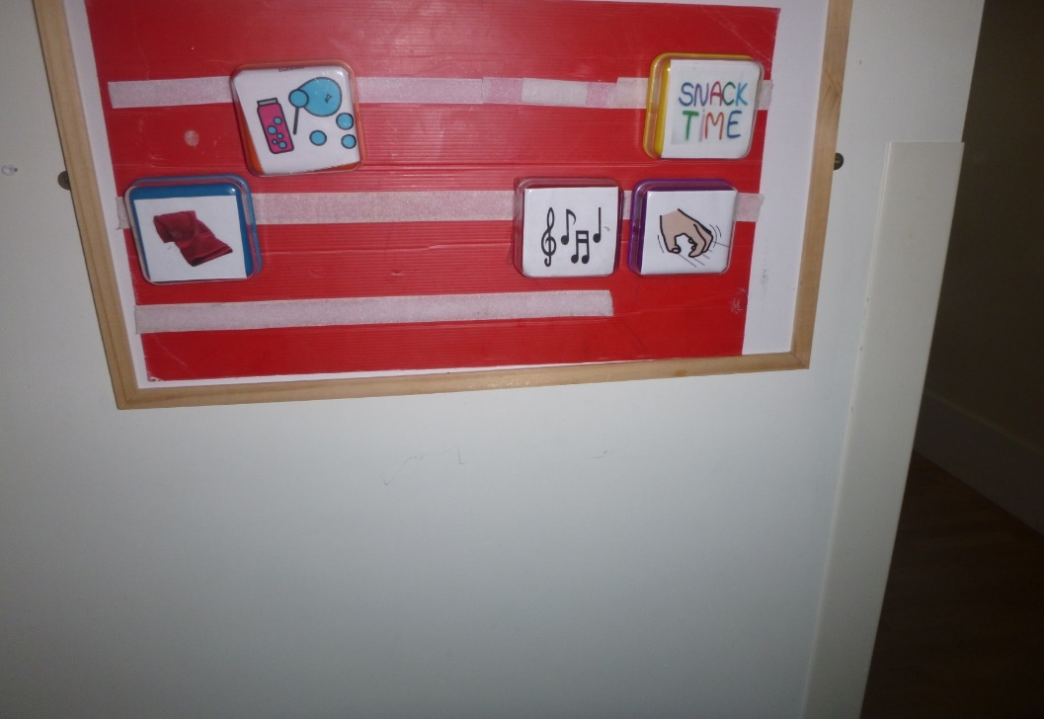
Simple switches can be used to develop communication

Slide 15
Language Acquisition and Motor Planning (LAMP)
What is LAMP?
Language Acquisition through Motor Planning (LAMP) is a therapeutic approach based on neurological and motor learning principles. The goal is to give individuals who are nonverbal or have limited verbal abilities a method of independently and spontaneously expressing themselves in any setting.
LAMP focuses on giving the individual independent access to vocabulary on voice output AAC devices that use consistent motor plans for accessing vocabulary. Teaching of the vocabulary happens across environments, with multisensory input to enhance meaning, with the child's interests and desires determining the vocabulary to be taught.
https://www.aacandautism.com/lamp

Slide 16
Transferring skills to other activities

Slide 17
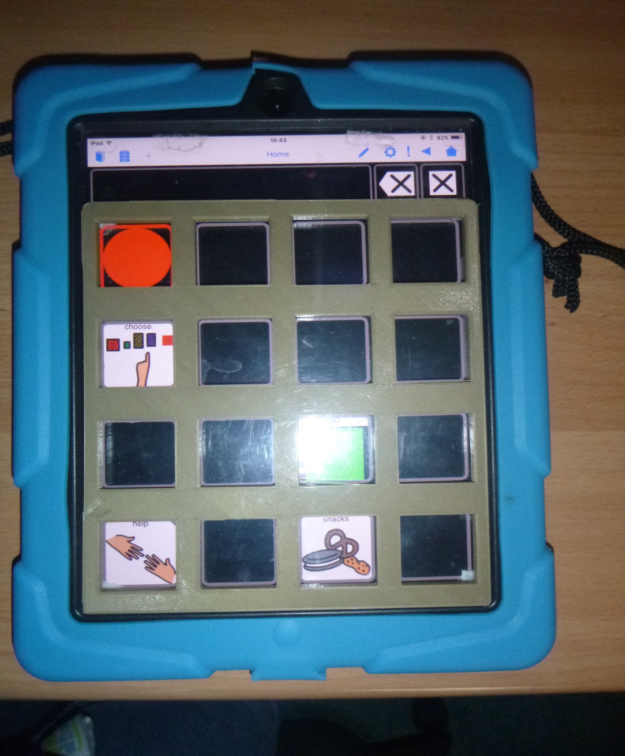

Slide 18
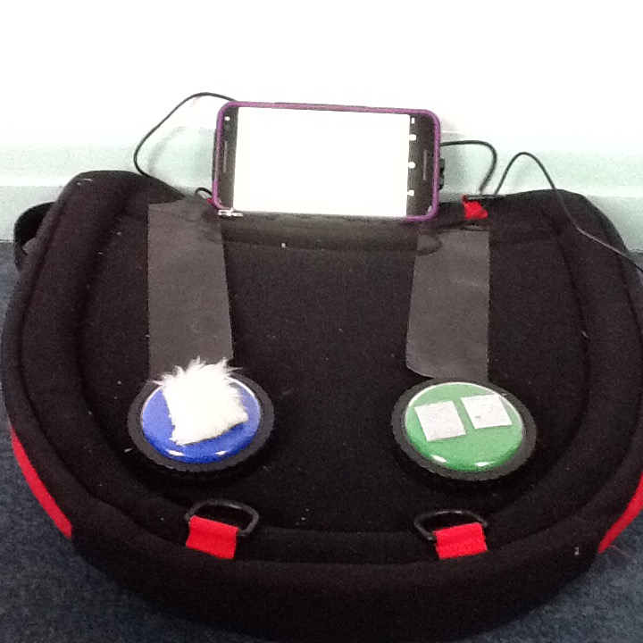

Slide 19
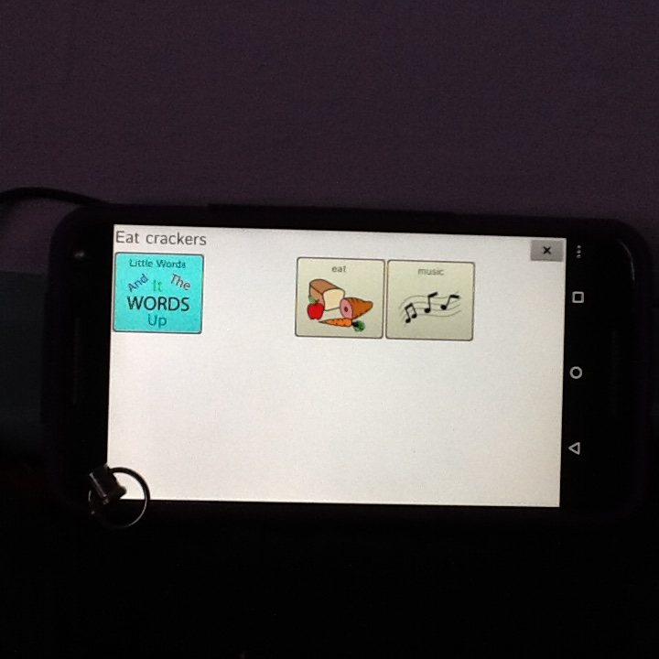
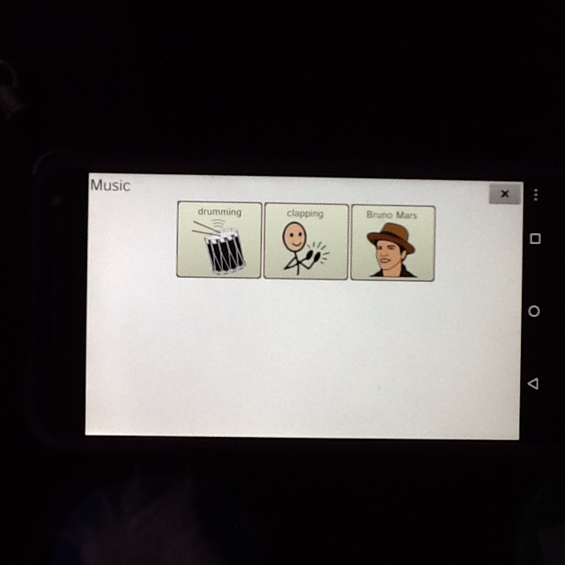

Slide 20
Auditory scanning
Auditory scanning can be introduced using switches.
Development of switch skills and teaching is required.
There are ideas to develop these in Switch Progression Map
http://www.inclusive.co.uk/articles/switch-progression-road-map
Can be 1, or 2 switches can be used
1 to scan along the vocabulary when pressed
2 to select the item when it is spoken
Can be a difficult system to teach, however it may be something to consider with someone who has a significant visual impairment and direct access (touch screen) is not appropriate.

Slide 21
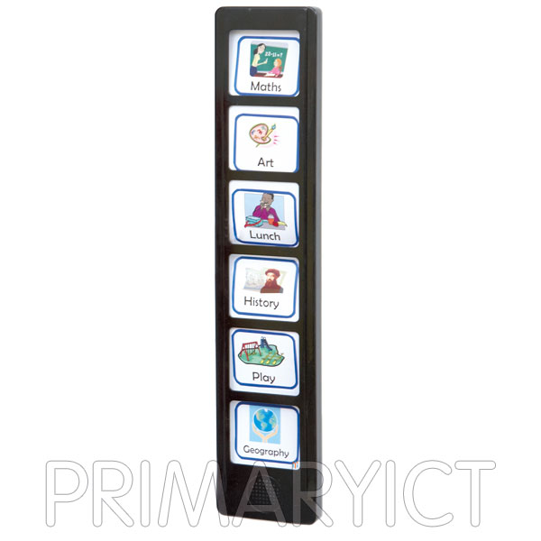
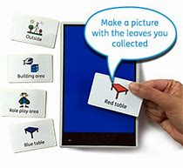
Auditory schedules
These can be used to promote independence in tasks by creating worklists

Slide 22
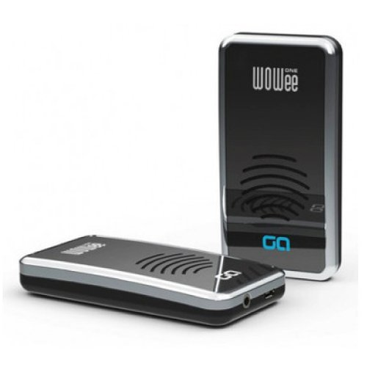
Wowee

Slide 24


