Slide 1
Who counts as MSI?
The current MSI position
Anthony McKay
Interim Head of Sense Specialist Services for Children and Young People
8th April 2019

Slide 2
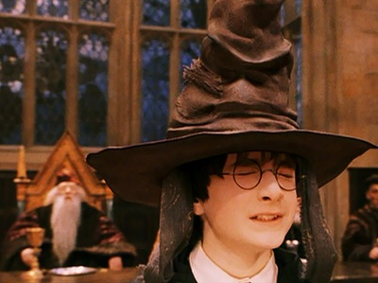
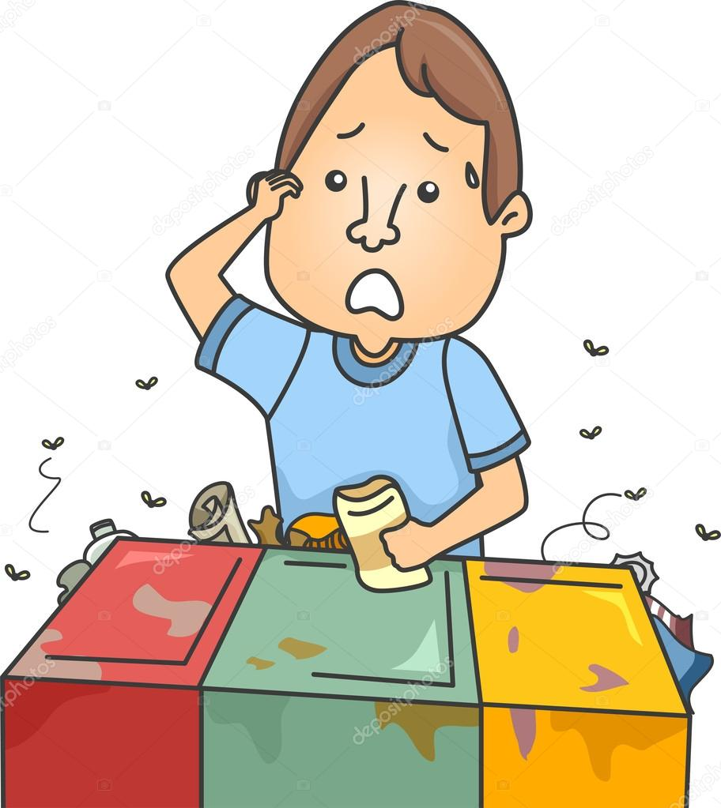
Who counts?

Slide 3
Deafblind
The two broad types of deafblindness are:
Congenital deafblindness is a term used if a person is born with a sight and hearing impairment. This may be due to infections during pregnancy, premature birth, birth trauma and rare genetic conditions.
Acquired deafblindness is a term used if a person experiences sight and hearing loss later in life. Anyone can become deafblind at any time through illness, accident or as a result of ageing.
What is deafblindness- (Sense, 2019)
https://www.sense.org.uk/get-support/information-and-advice/conditions/deafblindness/

Slide 4
Vision and Hearing Impairment
The definition of visual impairment is reduced vision not corrected by glasses or contact lenses.
Hearing loss exists when there is diminished acuity to sounds normally heard. The terms hearing impaired or hard of hearing are usually reserved for people who have relative inability to hear sound in the speech frequencies.

Slide 5
Dual-sensory impairment/ multi-sensory impairment (MSI)
Dual-sensory impairment or multi-sensory impairment are other terms that may be used if you have both sight and hearing impairments.
Many people take these terms to mean the same as 'deafblindness'. However, some people only use the term ‘deafblindness’ to refer to more severe impairments, whilst others prefer the term dual-sensory since it conveys more effectively the impact of being deafblind.
Multi-sensory impairment is considered a more appropriate term by some people, since the cause may be related to sensory processing, rather than the functioning of the eyes and ears. A person with sensory processing issues may have eyes and ears that function normally, but their brain has trouble filtering, organising and interpreting information taken in by the senses.

Slide 6
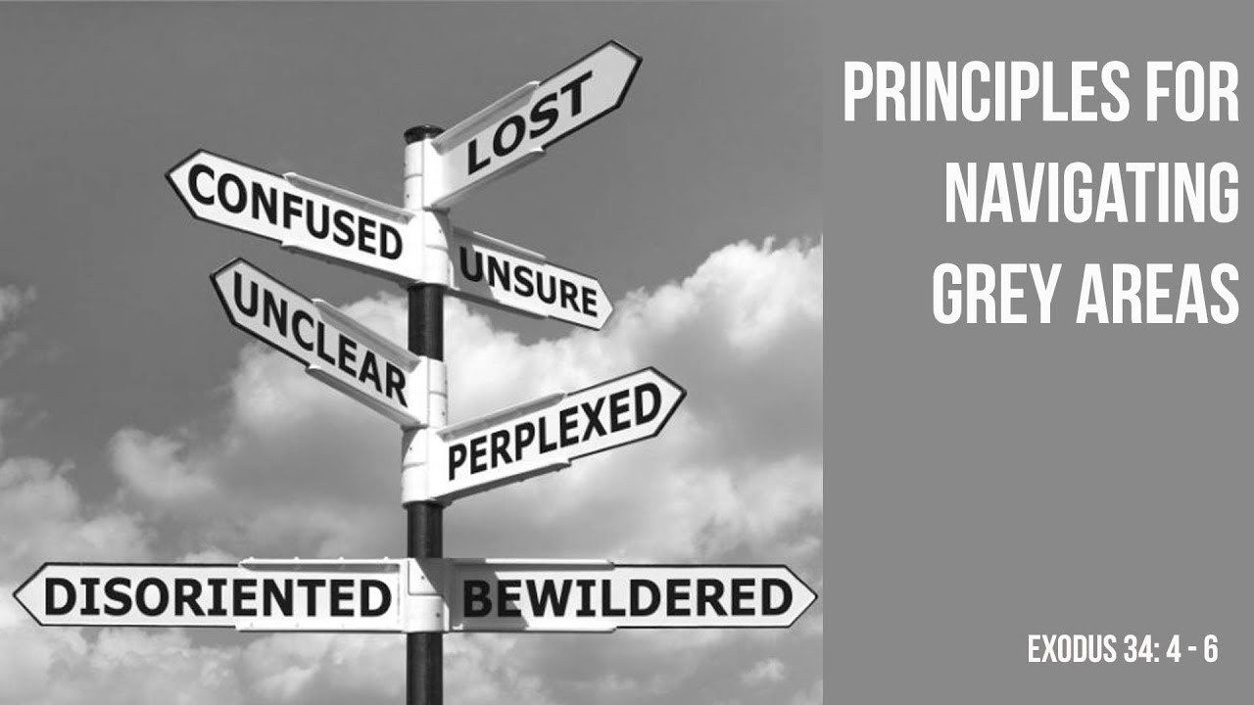
Multi-sensory Impairment (MSI)
Is a functional term that is frequently used alongside or interchangeably with deafblindness by educationalists, teachers and families because it communicates more effectively the impact of deafblindness.
(NATSIP, 2012)

Slide 7

SEND Code of Practice
Sensory and/or physical needs - 6.34
Some children and young people require special educational provision because they have a disability which prevents or hinders them from making use of the educational facilities generally provided. These difficulties can be age related and may fluctuate over time.
Many children and young people with
vision impairment (VI), hearing impairment (HI)
or a multi-sensory impairment (MSI) will
require specialist support and/or
equipment to access their learning,
or habilitation support. Children and
young people with an MSI have a
combination of vision
and hearing difficulties.

Slide 8
The Policy Statement
‘Pupil Level Annual School Census Definitions (PLASC)’, DfES (2005)
“(pupils with multi-sensory impairment)
have a combination of visual and
hearing difficulties. They are sometimes
referred to as deaf blind but may
have some residual sight and or
hearing. Many also have additional
disabilities but their complex
needs mean that it may be
difficult to ascertain their
intellectual abilities.”

Slide 9

NatSIP, 2017
A unilateral (or one sided) loss has significant implications for CYP with MSI (i.e. they are unable to rely on the other distance sense to compensate for/support access to information as would be the case for a child with a single sensory impairment).
  Mild multi-sensory impairment: Dual impairment with a mild loss in both modalities
  Moderate multi-sensory impairment: Dual impairment with a moderate loss in both or the most affected modality
  Severe multi-sensory impairment: Dual impairment with a severe loss in both or the most affected modality
  Profound multi-sensory impairment: Dual impairment with a profound loss in one modality and a mild/moderate loss in the other / Educationally blind and severe/profound hearing loss
  Multi-Sensory Impairment, support Allocation Matrix

Slide 10
NatSIP, 2017
In functional terms deafblind/multi-sensory impaired children and young people may include those with:
  Mild to profound auditory impairment and visual impairment;
  Mild to profound auditory and visual impairments and other significant disabilities;
  Central processing problems of vision and hearing;
  Progressive sensory impairments;
  Visual impairments and a possible loss of auditory processing mechanisms - associated with a physical disability or cognitive disability and communication delay.

Slide 11
So why is the picture changing?
The population of MSI learners continues to change with more complex aetiology due to the developments in medical science.
Increased understanding of the Neurological Impact on Vision and Hearing, eg:
  Auditory Processing Disorder
  CVI and associated conditions, eg:
-Prosopagnosia (inability to recognise faces)
-Prosopamnesia (inability to learn new faces)
  CAI (Cerebral Auditory Impairment)
Educational understanding and interventions have developed.

Slide 12

We are not clinicians
  We cannot diagnose…
      But, we cannot hide from our observations…
  If we have concerns we can put the functional assessments forward.
Education
MSI
Health
(social care)

Slide 13


Identification by condition?
A tricky path
to tread
  Early intervention.
  Awareness of causes for us as professionals is important, however in many cases a condition should not be definitive.
  Important to note that the situation can change.

Slide 14
‘MSI’ by association
It may be due to your skills, experience and knowledge that you are the best professional to support the learner.
Good practice to utilise
skills - but - be aware that
association can lead
to misconception.

Slide 15
CYP known to Sense (2019)
1257 Children and Young People (141 different causes):-
  341- Undiagnosed/ unrecorded/ unknown
  157 – CHARGE Syndrome
  92 – Usher Syndrome Types 1,2,3
  52 – Downs Syndrome
  39 – Prematurity
  24 – Birth complication/ trauma
  23 – Meningitis
  23 – Alström Syndrome
  13 – Bardet-Biedl Syndrome

Slide 16
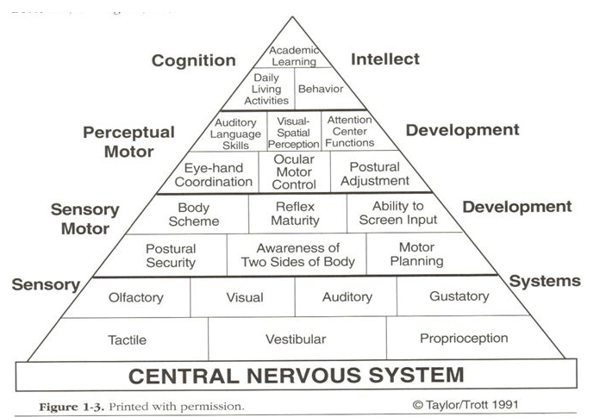
The Pyramid of Learning

Slide 17
An example…
Children with CHARGE syndrome are truly ‘‘multi-sensory impaired,’’ having difficulties not only with vision and hearing but also with the senses that perceive balance, touch, temperature, pain, pressure, and smell, as well as problems with breathing and swallowing, eating and drinking, digestion, and temperature control.
(David Brown, 2005)
https://www.chargesyndrome.org/wp-content/uploads/2016/03/Behavior-in-CHARGE.pdf

Slide 18

The Domino effect
‘The learner requires intervenor support.’
‘Can I say they are Deafblind for Social Care?’
  The role of the Intervenor is specialist to those who have a combined vision and hearing impairment and therefore difficulties with:
    Access to information
    Communication
    Mobility
  Perhaps they require 1:1
  support but is this an
  intervenor?

Slide 19
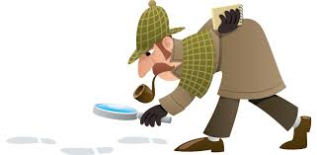

The Chameleon and the Detective
‘They are PMLD not MSI’
Potentially harder to identify- but not to be dismissed.
A changing condition ‘Their vision is fine so they don’t need any involvement’
  Who is the expert to know when their vision is not fine?
The impact of a changing condition is
more than just vision and hearing impairment.

Slide 20

What do you think?

