Slide 1


Joined‐up working: How it works in practice
Kim Hodge
Lead Deafblind Consultant QTMSI
Sensory and Communication Team
Inclusion Services Suffolk County Council

Slide 2

SEND Code of Practice
Collaboration /Joined up working
Pg. 24, point 1.22 states the need for
“Collaboration between education, health and social care services to provide support if children and young people with SEN or disabilities are to achieve their ambitions and the best possible educational and other outcomes, including getting a job and living as independently as possible. Local education, health and social care services should work together to ensure they get the right support”.
N.B
The Send reforms reiterated the parental right to mainstream placement”

Slide 3
Using A business model states …..
With a collaborative culture, you gain the ability to bring products to the market faster.
Teamwork and communication speed up the entire process and make it easier to produce anything.
The entire organisations ability to create value accelerates as a result.
Applying this to our children and young people
You have the ability to ensure needs are understood, met and services are put into place in a timely fashion with outcomes that are measurable and achievable
Parents, families, young people and children are central to the process, have a voice and are involved in a transparent process.
Currently we are all striving to prove progress, value added and outcomes that demonstrate that correct intervention make a significant difference. Therefore working together raises the profile for this group

Slide 4
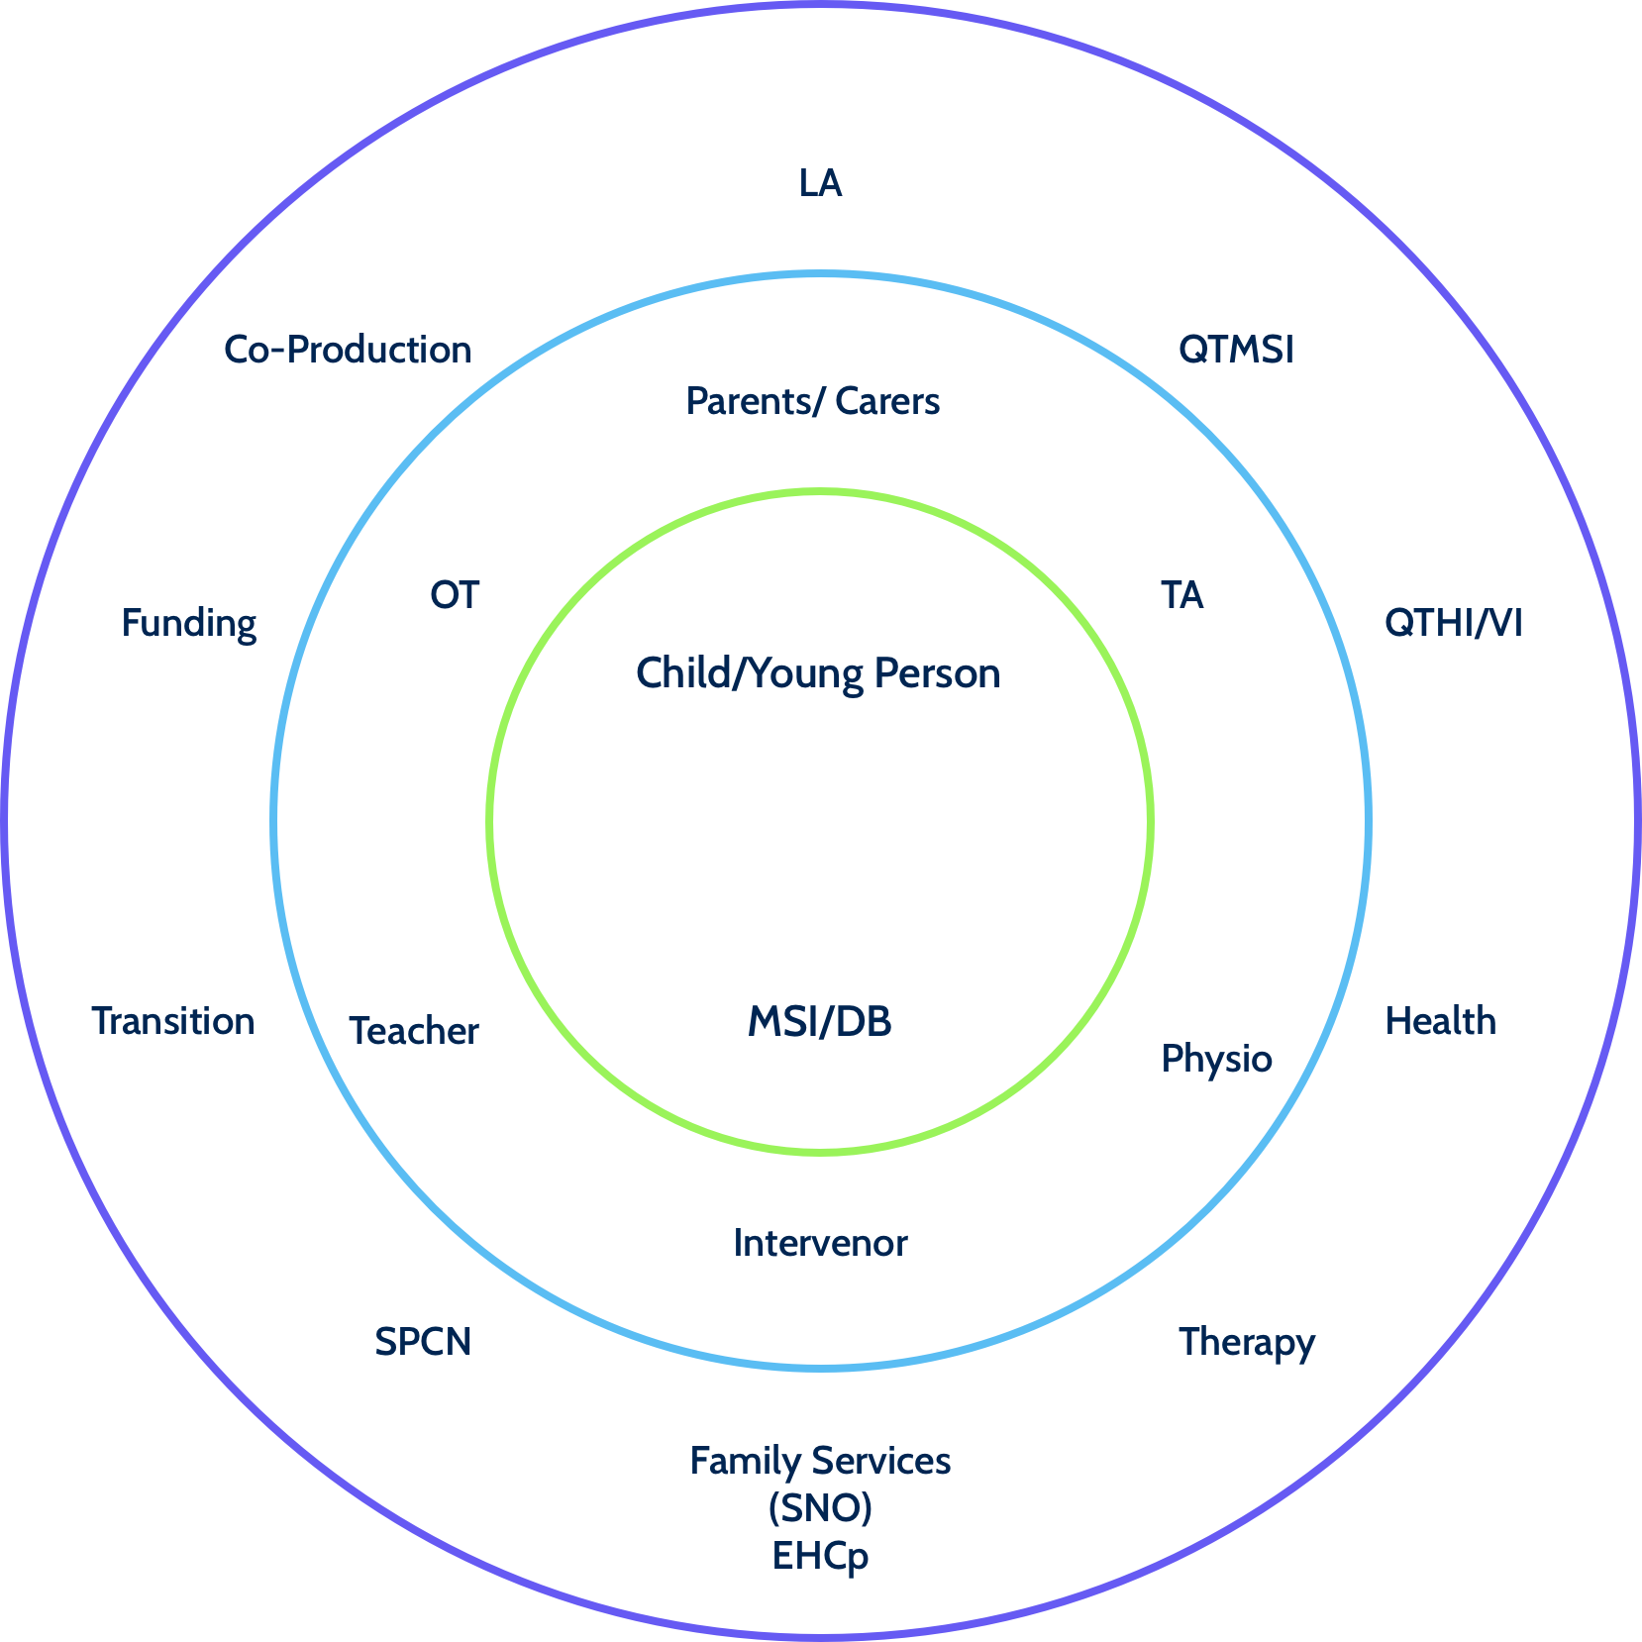
Working Together Needs, Support and Intervention
Working together is about timely identification of support and intervention, services working together to support progress educationally, socially and emotionally.
These are only examples ….
The QTMSI in school
The QTMSI in Local Authority sensory team – Is it easier to access and know of the differing services ?
Do they have a different role?

Slide 5
How it works in practice
In my experience it
Can be entirely dependent on the individuals involved and their dedication to ensuring all needs are identified and met
It may be dependent on personal knowledge and links
It is time consuming and frustrating at times
It can be incredibly rewarding – the smiley cat !
It allows for transparency building parental trust
The good relationships built on trust and knowledge allow for open discussion and improvement
Joint working allows for a process of review and change when necessary in the best interests of the child

Slide 6
Child a – when it works – some of the services that work together
Identification at birth, Ushers Syndrome – service from sensory team from new born hearing screening at 48 hours, QTHI, QTVI and QTMSI involved at 3 days.
Has had additional services from 3 months – continued ophthalmology, audiology supported clinic visits, physio, OT, SLT, social care(sensory trained), intervenor service, Educational phycologist, QTMSI – key person for coordination of services.
Transition to school placement – EHC plan with intervenor support full time involved liaison with family services(SNO,) Early years funding agreed to support intervenor costs, SEP panel agreed additional costs, involvement of all school based services SENDco, SLT, Habilitation/mobility, Family services, provision of IT equipment HI and Vi equipment
Social care and QTMSI intervention and working with children in the school over social emotional support for child A with her involvement
Family are fully involved and have been from day one they also have supported all suggestions for ideas at home
There is very close liaison between home and school and intervenors
There is a continuous cycle of plan review do …..
This child is top of her class in all areas academically work is still ongoing with the social emotional support needs

Slide 7
why it works …EXAMPLES
Everyone now understands what the other services do and can contribute
Funding is secure and providers of this understand why it is necessary – this was a big piece of work - we sometimes assume they know why we want funding and what the roles are.
The setting works with the intervenor/QTMSI and values the support, intervenors feel valued by the setting. Communication between teachers, staff parents and additional services is excellent and the expectations of each others roles are understood.
Tight, planned transition between year groups with all involved
Intervenors work with SLT, OT and physio and carry on their programmes of work – discuss and evaluate, then review and feedback info to home and services – work is coordinated

Slide 8
Child B
Examples of why it initially didn’t work - has now been overcome but with considerable unpicking and work
Services didn’t understands each others roles – we assumed each other knew what they did e.g. intervenor role
Funding didn’t understand the necessity for support
Person writing the EHC plan lacked experience of roles and took out intervenor and replaced with TA – draft did not come to sensory service !
Teachers reluctance to include the child – fear of the unknown. Lack of experience. Worrying about her progress tracking !!

Slide 9
In practice joint working – the Challenges/Encounters - questions?
Is it a different picture for those working in settings to those working for the local authority ?
How do we balance support versa independence –success all about collaboration at a settings level ?
LA QTMIS how do we support early intervention when often it is the schools that get the funding – e.g. intervenor service
How can we prevent this being a lonely place for parents/carers of MSI children and young people ?
Collaboration at point of transition e.g. post 16 can be a challenge - is this a capacity issue?

Slide 10
Suffolk Parents Carers Network Feedback
In response to the SPCN review of our service our drive to co produce and work in collaboration with services centred around the child has lead to all the feedback being positive and highly recommended for MSI e.g. those receiving the intervenor service, however these are small number.
Quote …
The feedback of using things such as the MSI individual programmes of support to track progress has been commended by parents as enabling them to see and track small step progress rather than their children being missed from reports that only demonstrate large steps of progression or academic achievement.

Slide 11
The future
There is a drive to work in collaboration taken from recent legislation and acknowledgement that co production is the key
The challenge that faces us all is being able to measure our impact through this joined up working and to create opportunities for the future

