Slide 1

Sensory Processing:
An Educational Perspective
Ellie Davies Moore
MEd. MSI, DipCOT, SROT

Slide 2
A blast of sensory learning!

Slide 3
Sensory Processing
  The process that organises sensation from
  one’s own body
  and the
  environment
  thus making it possible to use
  the body effectively within the environment

Slide 4
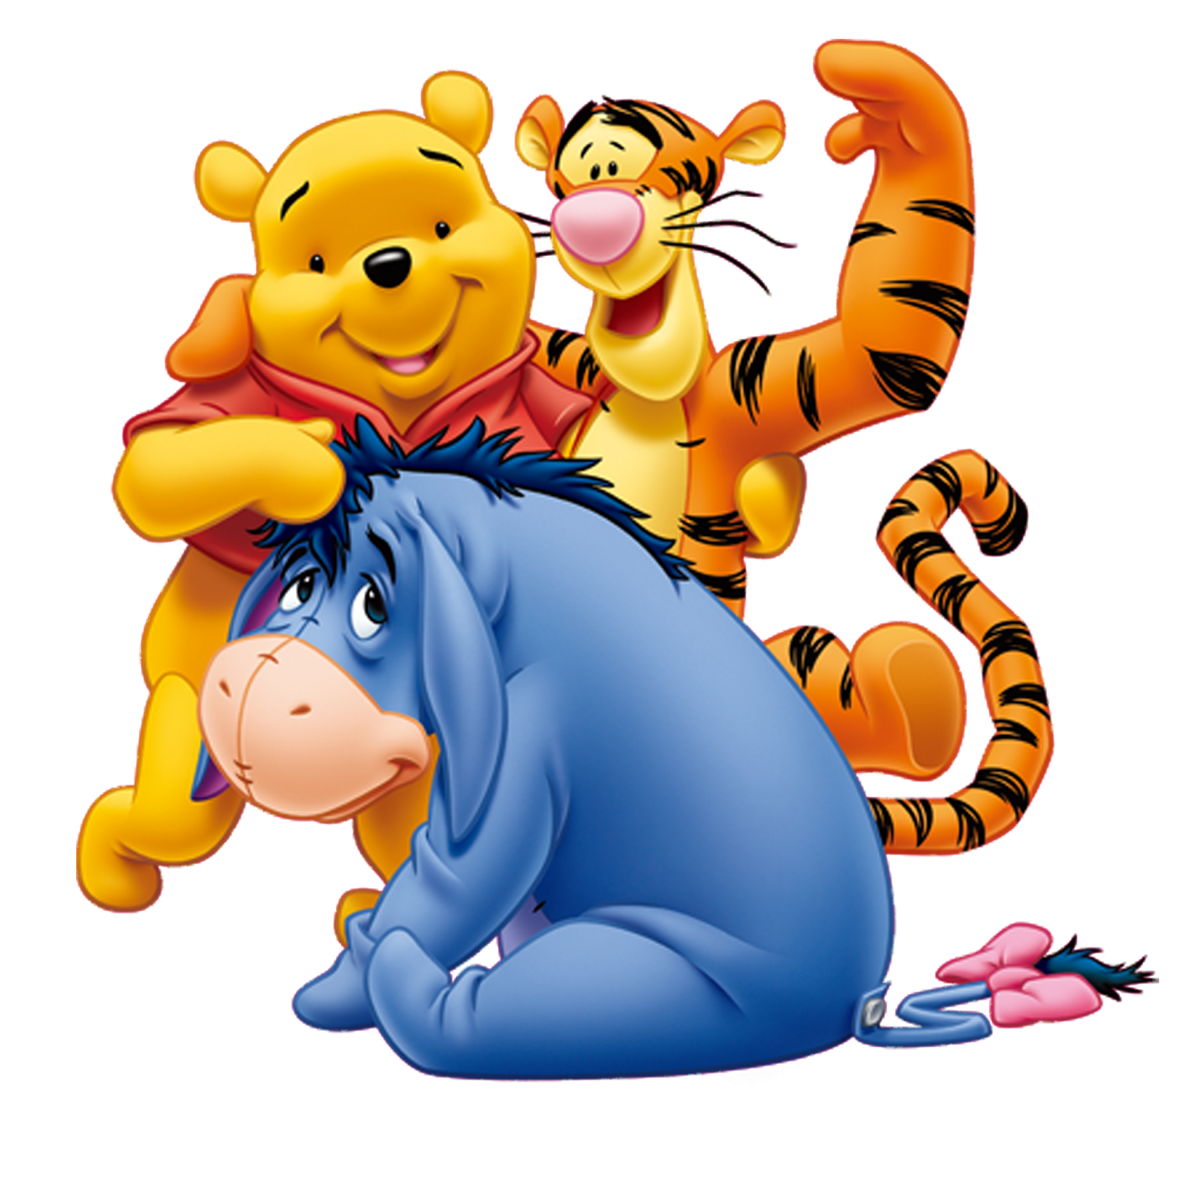

Slide 5
Research positively links the following areas of functional difficulty with sensory processing difficulties
Play activities
Family outings
Everyday living skills e.g. dressing
Everyday routines
Leisure activities
Work
Learning
Participation in mealtimes
Social ability and communication
Outten & Benevides, 2011; Cermak, Curtin & Bandini, 2010; Lane et al., 2010; Ashburner, Ziviani & Rodger, 2008; Baker et al., 2008; Hilton, Graver & LaVesser, 2007; Hilton et al., 2010; Hochhauser & Engel-Yeger, 2010; Reynolds et al., 2011; Watson et al., 2011

Slide 6
Sensory Processing
What is established is that sensory processing
affects behaviour and function
but what makes it hard is that
an exact cause and effect scenario has not been established
(Schaff & Mailloux, 2015)

Slide 7
Let’s consider our goal for the individual with sensory processing difficulties?
Function
Adapt behaviour
Learn skills
Well-being/autonomy

Slide 8
Goal - sensory autonomy
Risk of over-dependence/ learned helplessness
Janssen, Riksen-Walraven and van Dijk, 2002; Van Hoorn et al., 2007
Inability to effect change in environment
Askins et al. (2013) and Gilfoyle, Grady and Moore (1990)
For effective control over their sensory environment we need to teach individuals they they can change their environment and make themselves feel better and function better

Slide 9
Creating autonomy in sensory processing
Importance of partnership and trust
Observational assessment process
Communication and consistency

Slide 10
Work in partnership – build the trust
The child must feel listened too and that you accept their sensory system is just how it is.

Slide 11
Observational assessment in sensory processing
Identify a behaviour you think happens
because the individual has poor
sensory processing.
Try some things out – experimentation!
Work on this together.

Slide 12
Communication
Encourage the individual to communicate their sensory needs. You don’t have to be using words.

Slide 13
Make sure you always act if an individual communicates that they need something changed
Make sure everyone knows the plan!

Slide 14
You can change things to make things easier/different for the individual.
Remember you’re both detectives

Slide 15
Thank you for listening
I’m available on the Fiddlit stall over lunch
www.Fiddlit.co.uk for further information on the senses and being a sensory detective in education
Contact me : fiddlit@gmail.com

