Slide 1
Assistive Technology & Augmentative Alternative Communication (AAC) in a Complex Needs Setting
Beccy Timbers
Speech & Language Therapist

Slide 2
Assistive Technology can be used to support receptive skills and develop independence in activities.

Slide 3
Switches using Bluetooth can connect to Apple and other tablets
Bluetooth adapters that have switch sockets and various settings meant that this system enabled the user to play, skip and pause his music independently.

Slide 4
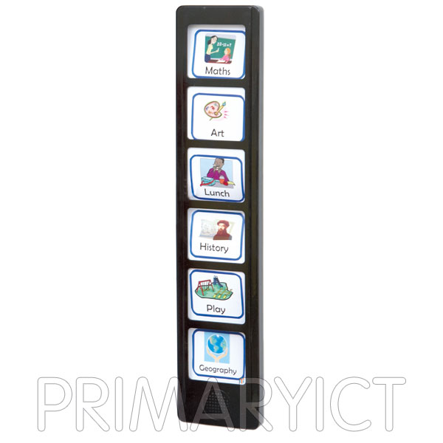
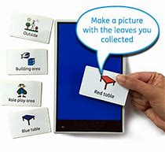
Auditory schedules
These can be used to promote independence in tasks by creating worklists
Sequencer
Prox Pad

Slide 5
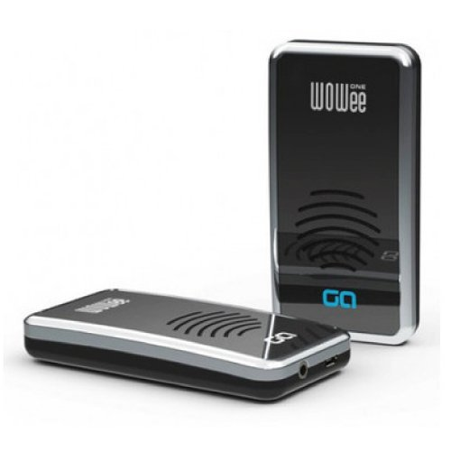
Wowee’s produce vibration

Slide 6
What is “AAC”?
Augmentative and Alternative Communication (AAC) is the term used to describe various methods of communication that can ‘add-on’ to speech and are used to get around problems with ordinary speech.
(Communication Matters https://www.communicationmatters.org.uk/page/what-is-aac)

Slide 7
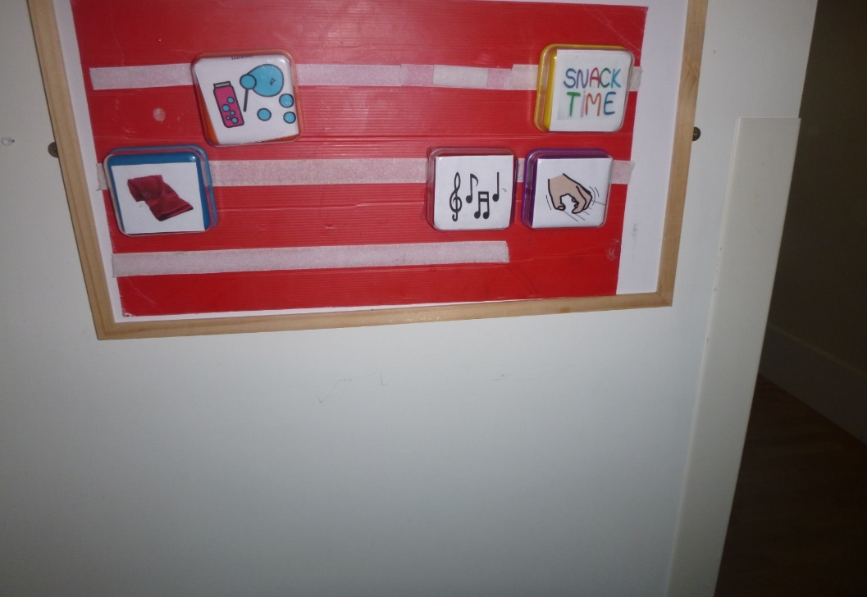
Simple switches can be used to develop communication
Big Points can be used to develop auditory choice boards

Slide 8
How it developed
Textured switches
Switches added through Intensive Interaction/Developing interests
Gradually moved board further away giving a verbal prompt ‘choose’
Quickly started to problem solve, when water spray ran out, he would find board and press’water spray’ and pass empty bottle.

Slide 9
Language Acquisition and Motor Planning (LAMP)
What is LAMP?
Language Acquisition through Motor Planning (LAMP) is a therapeutic approach based on neurological and motor learning principles. The goal is to give individuals who are nonverbal or have limited verbal abilities a method of independently and spontaneously expressing themselves in any setting.
LAMP focuses on giving the individual independent access to vocabulary on voice output AAC devices that use consistent motor plans for accessing vocabulary. Teaching of the vocabulary happens across environments, with multisensory input to enhance meaning, with the child's interests and desires determining the vocabulary to be taught.
https://www.aacandautism.com/lamp

Slide 10
iPad
Research into raised grids and the appropriate app, he can’t see the screen so grid is needed so he can locate the vocabulary he needs.
Joint session with OT to look at fine motor skills and size of grid required
Discussion with mum, school staff and residential staff as to appropriate vocabulary
Training of staff and Mum on how to use
Thorough information available with the iPad for anyone new working with him.
All cells are always in the same place, when more are added or a replacement device is needed then all vocabulary needs to be in the same position.
Introduced during familiar session, location modelled during motivating activities
Ensuring that he has opportunity to use as often as possible.
Is now available at all times so that he can request different activities and items

Slide 11
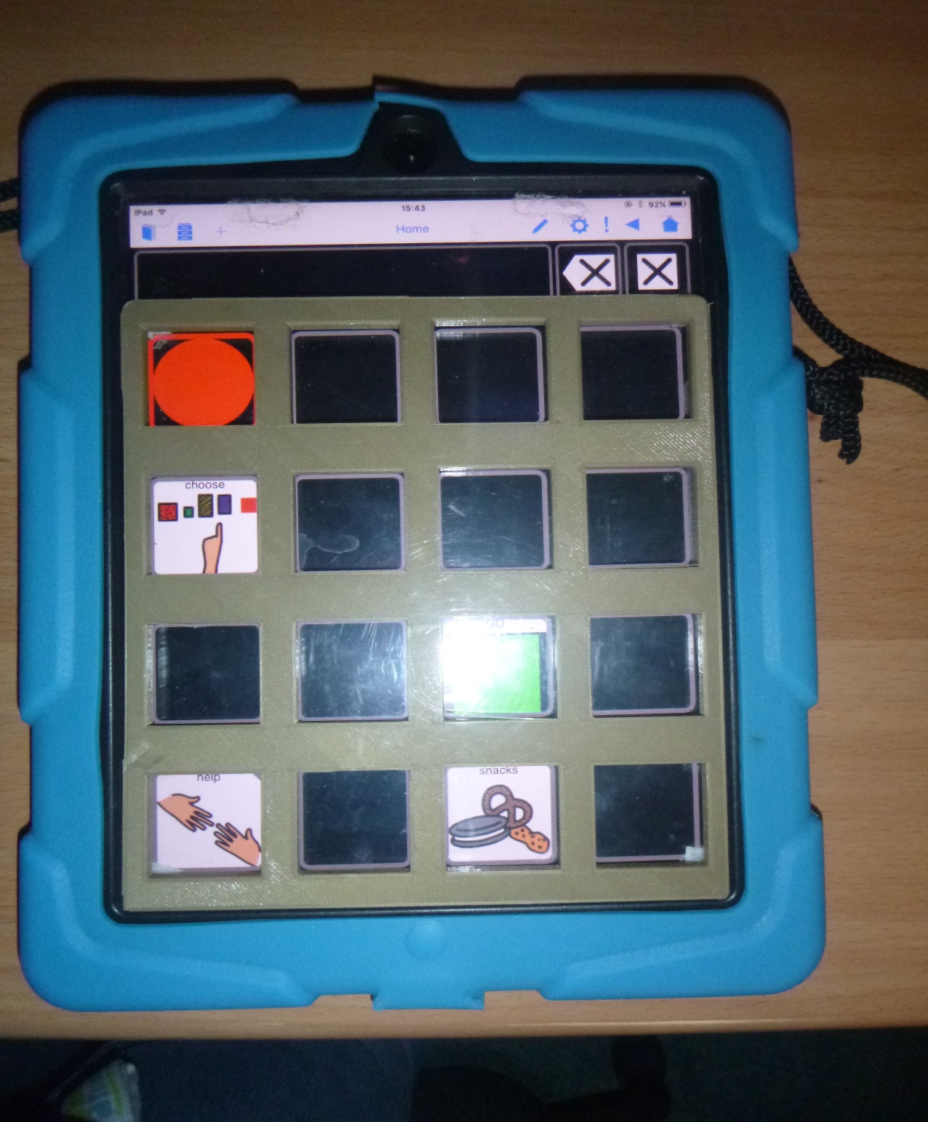

Slide 12
Auditory scanning
Auditory scanning can be introduced using switches.
Development of switch skills and teaching is required.
There are ideas to develop these in Switch Progression Map
http://www.inclusive.co.uk/articles/switch-progression-road-map
Can be 1, or 2 switches can be used
1 to scan along the vocabulary when pressed
2 to select the item when it is spoken
Can be a difficult system to teach, however it may be something to consider with someone who has a significant visual impairment and direct access (touch screen) is not appropriate.

Slide 13
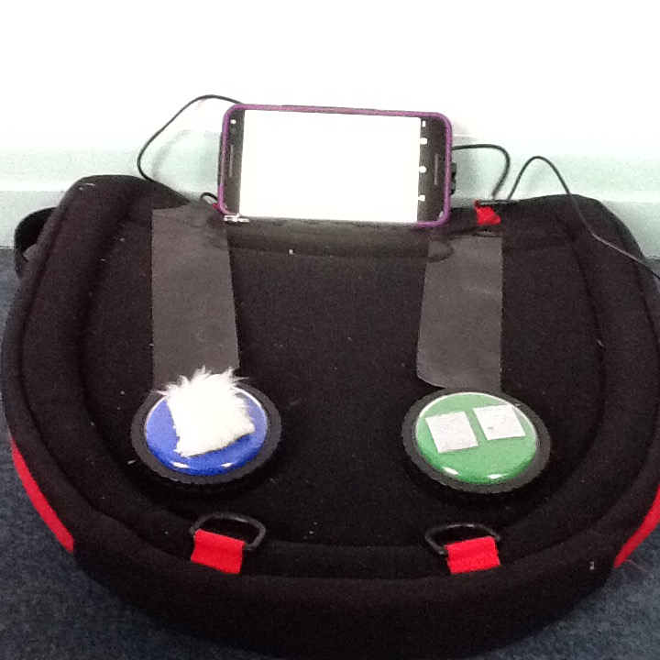

Slide 14
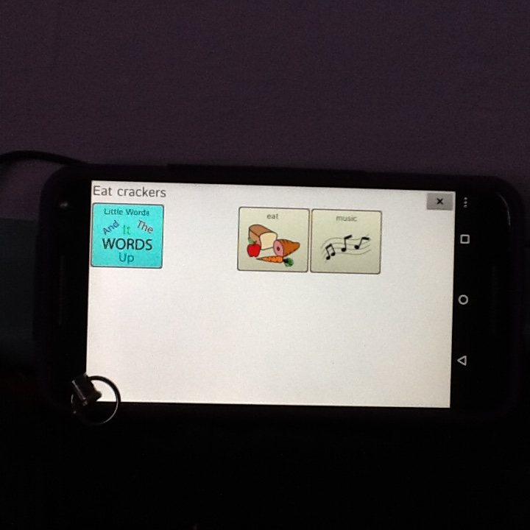
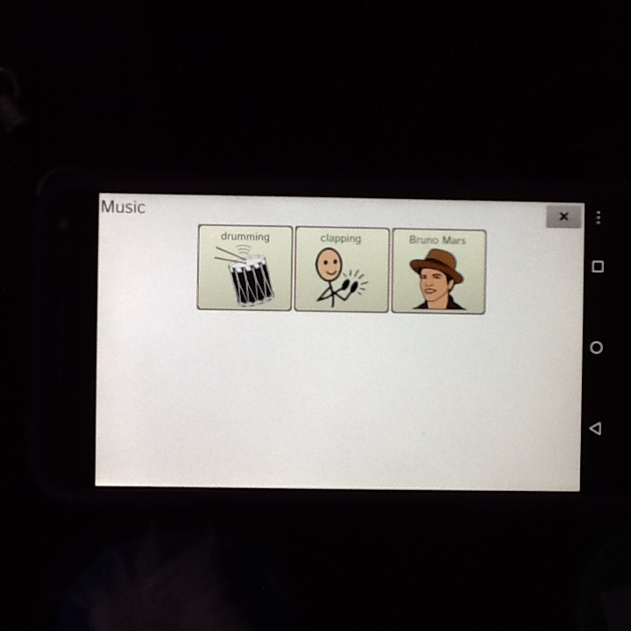

Slide 15
As technology evolves and software develops, the opportunities to use Assistive Technology with children and young people with complex learning needs, including those with multi-sensory impairments increase.
Communication software is becoming more accessible to those with hearing impairments who are able to understand symbols.

Slide 16
Previously hi-tech AAC devices would present a written word in the output message bar.
Recently developers have enabled the symbol to also be added to this function which has enabled me to introduce this type of communication with children who have an understanding of symbolic language but are unable to here a spoken output.

Slide 17
What did I need to think about?
Vision (some cells were difficult visually, consider colour and size
Vocabulary – start simple and build up or full software package
What symbol set? What software?
Does the symbol transfer to the message bar as unable to hear a voice output. This limited the software packages available
Devices need good casing, handle, stand, this again limited the devices available
Notes:
Vision, display, vocabulary, symbol set, software (symbol to message bar)

Slide 18
What did I assess?
There aren’t any formal assessments that are accessible due to vision and hearing impairment
Resources made to look at:
Size of cell – picture matching
Symbolic understanding – photo and symbol matching
Categorisation – could they categorise items? Ie clothes, food, transport? If so this opened up the vocabulary packages that could be introduced.
Notes:
No formal assessments, but used picture matching, categorisation,

Slide 19
A way of measuring progress
C.O.D.E.S framework
Developing language through technology
The communicative competencies defined in this early study has influenced assessments such as the C.O.D.E.S (Competency, Opportunities, Driving Communication Forward, Engagement, Skills Acquisition) (Jans, Wise & Goodwin, 2011) which enables clinicians to identify strengths and areas of weakness when assessing and implementing AAC. This is however a ‘framework’ and provides guidance of the areas to assess but does not specify on how to do this in terms of activities or a specific resources meaning practitioners are still providing and choosing the assessment tools for each of the areas without a clear evidence base

Slide 20
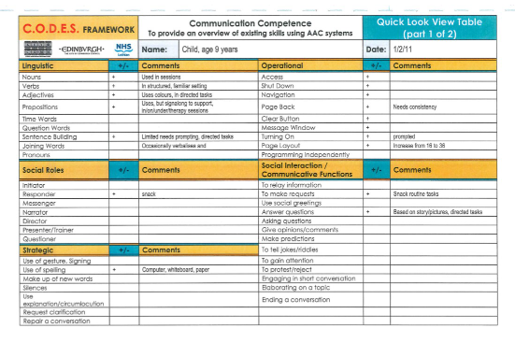

Slide 21
What have been the benefits?
Increased receptive skills as it is used by both communication partner and learner
Wider range people able to communicate with them
Families report that they are having ‘conversations’, retelling of events which don’t take place through sign
It is still a learning process for all of us, but it’s an exciting one!

Slide 22
What has made these systems successful?
Proactive Communication Partners
This has been the key to these systems being effective and functional.
Sessions were/are delivered by the Speech and Language Therapist over a long period of time, however, having confident key staff who could see opportunities to develop the skills enabled the learners to embed these throughout the day.
Recognising communication opportunities during the day
Remembering that these individuals all have a Total Communication approach. Using AAC as an extension of signing, gesture, Picture Exchange and gives the opportunity to extend their vocabulary further as well as enabling them to be understood by unfamiliar communication partners.

Slide 23
References
http://www.inclusive.co.uk/articles/switch-progression-road-map
Jans, D., Wise, R., & Goodwin. S. (2011) C.O.D.E.S Framework. Keycomm Resource Centre
Lewis, C & Lowther, J. (2001) CHARGE Association: Symptoms, behaviour and intervention, Educational Psychology in Practice, 17:1, pp69-77
Mar, H. & Sall, N. (1994) Programmatic Approach to use of Technology in Communication Instruction for Children with Dual Sensory Impairments. Augmentative and Alternative Communication, 10(3) pp138-150
The Centre for AAC & Autism
https://www.aacandautism.com/lamp

