Slide 1
Invest in the Future
Invest in Assistive Technology
Jane Sharp QTVI, VIEW

Slide 2
The APPGAT
Mission:
to promote policy that takes advantage of technology to make society more inclusive for all

Slide 3
The Issue
“… technology … looks familiar to children and doesn’t stand out. But this technological progress hasn’t always been matched by the level of impact in schools that we want to see”
Lord Low, chair of the APPGAT

Slide 4
Aim
“we have to get in a position where every child is given the opportunity to use assistive technology.”
Angela Rayner MP, Shadow Secretary of State for Education

Slide 5
Strategies
1. To inform schools of the potential of AT
“The central issue is the benefits of assistive technology for children and young people: it can help them study and learn independently and in step with their peers”
Lord Addington

Slide 6
Strategies
2. To support schools to include the use of AT in their classrooms through access to expert advice
“Schools don’t know what they don’t know”
Sharon Hodgson MP

Slide 7
Strategies
3. Improve the procurement model
“one of the major causes of the challenge… lies with the devolution of procurement to schools. In England especially, local educational authorities have pulled back from procurement and we are left with a vacuum in which schools are expected to make decisions with little or no guidance… schools risk making uninformed decisions or failing to invest in technology at all… and pupils lose out on the opportunity to learn using assistive technology.”
Patrick McGrath (British Assistive Technology Association (BATA))

Slide 8
Strategies
4. Ensure that the exam system fully supports the use of AT
“For the technology to be fully integrated into teaching, it must be part of assessment as well”
Dr. Abi James (chair of the British Dyslexia Association’s New Technology Committee)

Slide 9
Strategies
5. Ensure that the needs of pupils with SEND are recognised, even in this time of financial difficulty
“we must ensure that Education Health and Care plans, which often include assistive technology, truly reflect children's needs as opposed to the budgetary constraints of the school or local authority.”
Angela Rayner MP

Slide 10
Strategies
6. Invest in AT
“I don’t even think it costs that much: it costs more not to do it.”
Angela Rayner MP

Slide 11
Progress
"Technology can help access and inclusion for children with different backgrounds and abilities. This can be especially powerful in supporting students to learn alongside other children irrespective of their needs.”
Damian Hinds MP, Secretary of State for Education
New regulations require FE colleges and universities to make VLEs accessible

Slide 12
Support for AT
The UN and the WHO regard access to assistive technology a basic human right.
It is an investment – with lifelong benefits
Student experience (the original presentation contained audio here)

Slide 13
Current situation
5-15% of people who could benefit from its use do not have access to assistive technology (WHO)
40 – 75% of those issued with AT don’t continue using it
In schools, default for pupils with a VI is reader/scribe support

Slide 14
Moving away from adult support:
AT package
Voice recorder
e-Readers
Screen setting options on standard devices
Electronic magnification devices and software
Audio supported reading software
Text to speech and screen reading software
Braille notetakers
Braille displays
Photo recognition apps
Dictation software (speech to text)

Slide 15
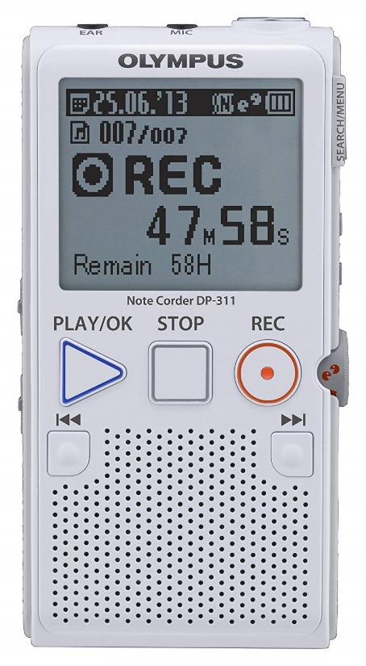
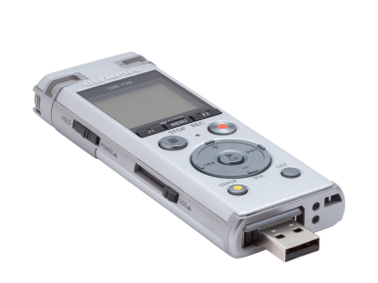
Voice Recorders

Slide 16
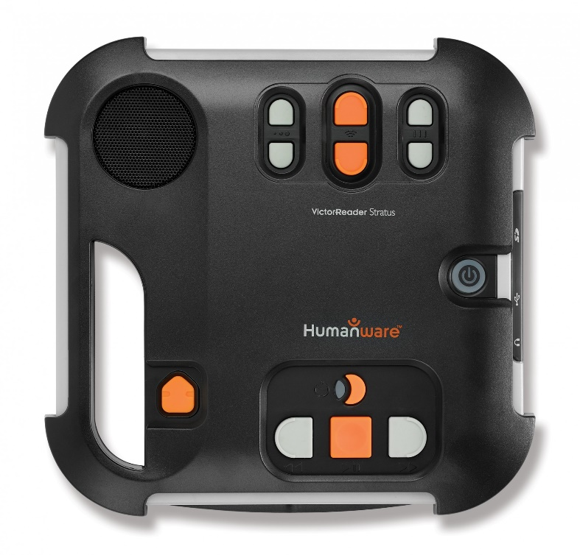
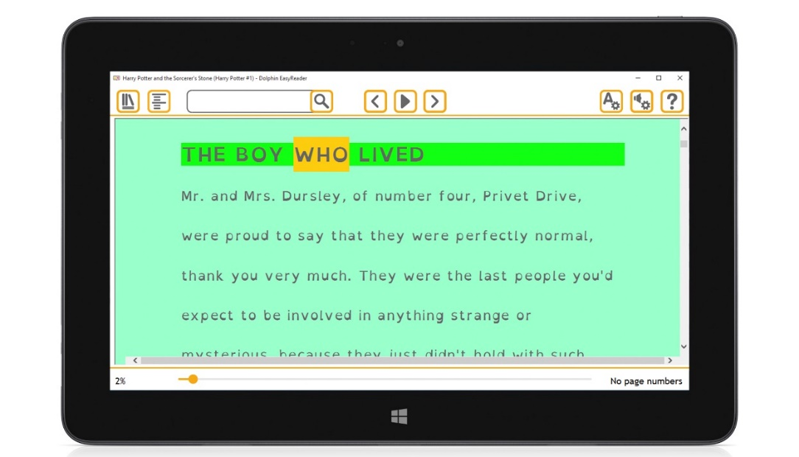
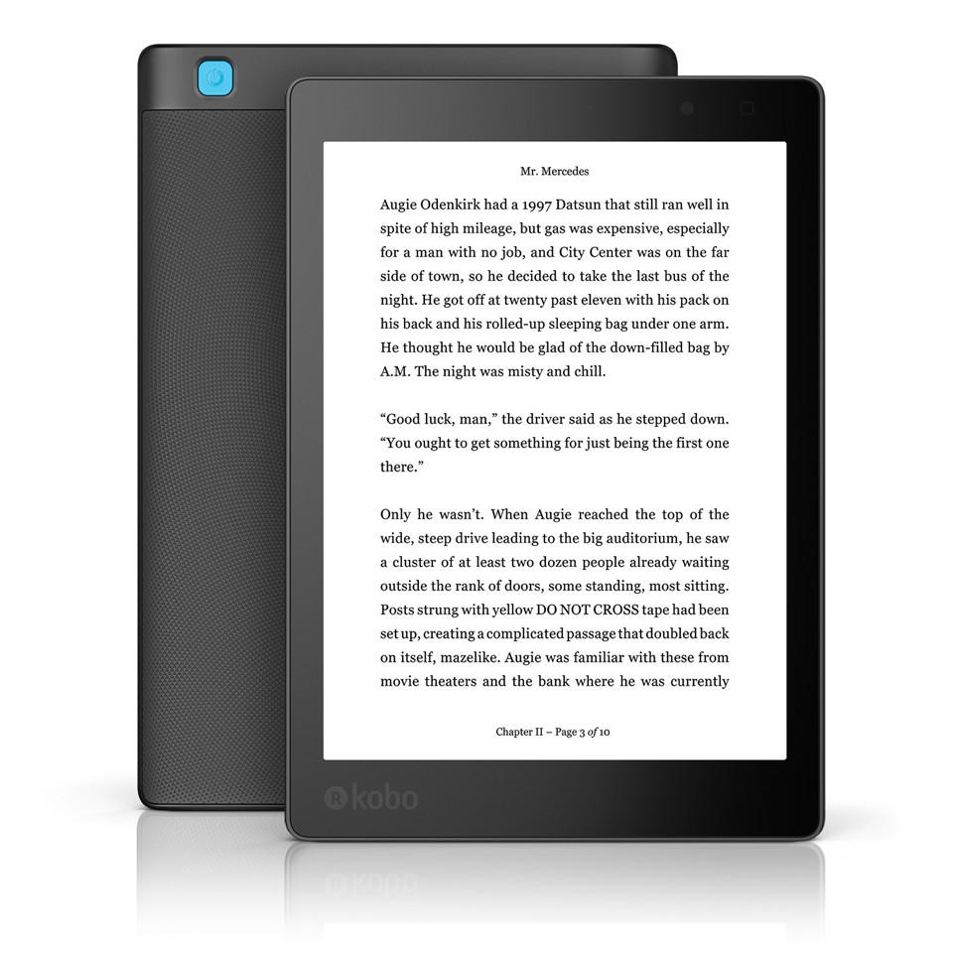
e-Readers and audio supported reading software

Slide 17
Screen settings on standard devices
Touch screen
Choose a built-in high contrast theme
Change your desktop background image and color
Change the size of text and icons
Select a different mouse pointer
Set the thickness of the blinking cursor
Use built-in magnifier

Slide 18
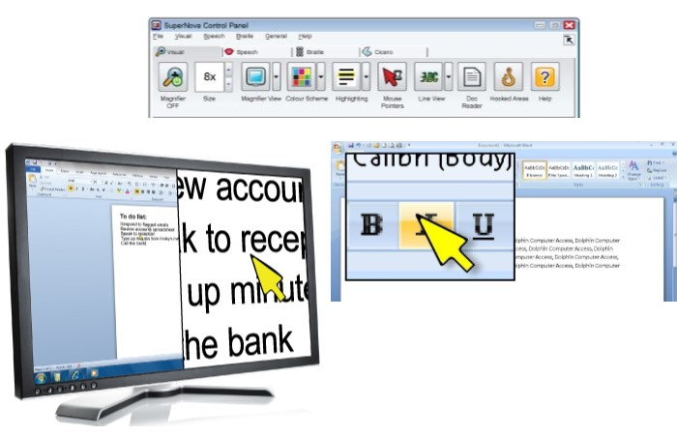
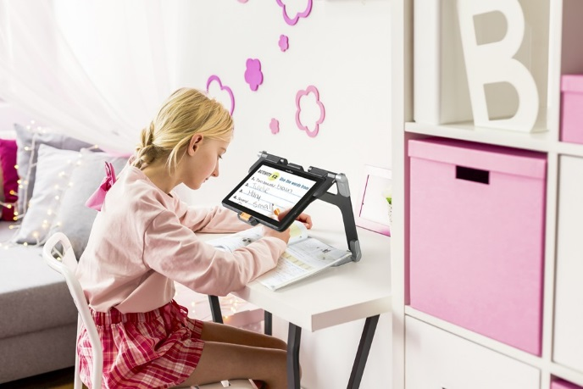
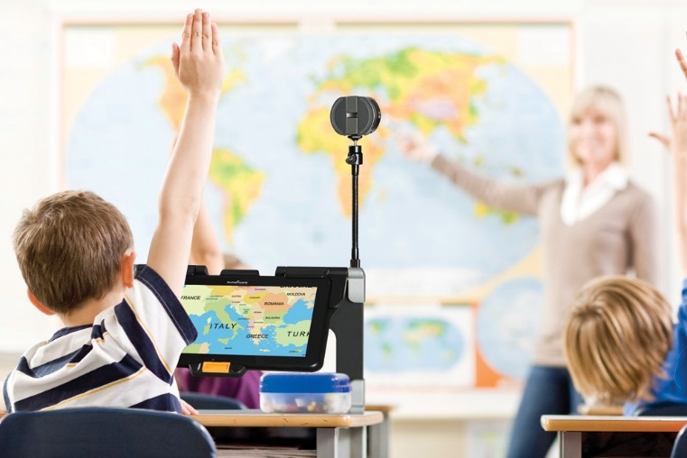
Electronic Magnification

Slide 19
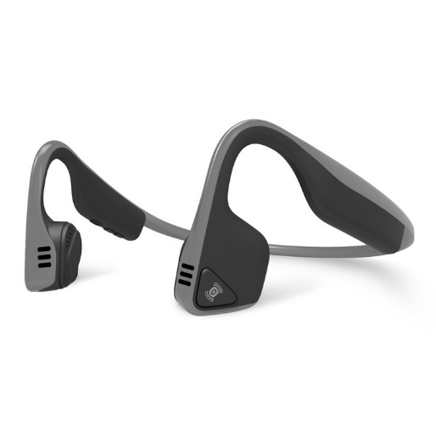
Text to Speech and Screen Readers
Portable TTS devices (‘pens’)
Inbuilt or compatible software
Buy a natural sounding voice
Bone conduction headphones

Slide 20
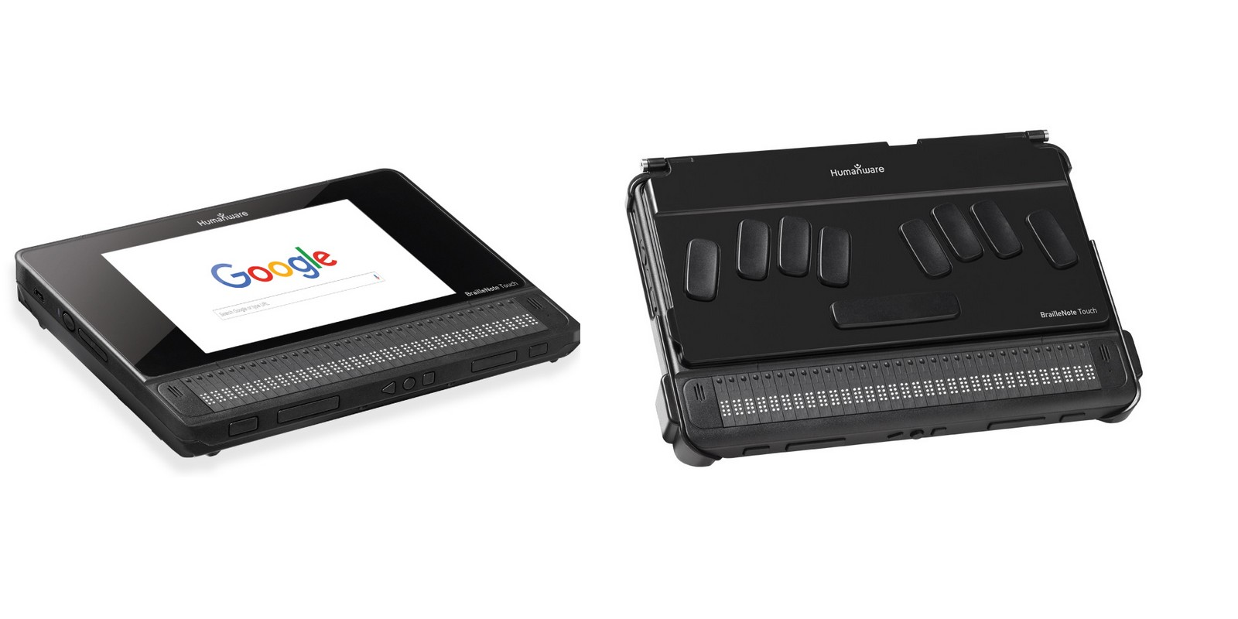
Braille Notetakers

Slide 21
Braille displays
(the original presentation contained video of a student using a braille terminal here)

Slide 22
Accessibility apps
Object recognition apps:
Need a mobile device with a camera
AI Poly, Seeing Eye, Tap Tap See etc.
Navigation apps
(the original presentation contained video here)

Slide 23
Voice recognition and dictation software: not a first choice solution
Electronic assistants
Smart speakers
Dictate function on computers and mobile devices
Speech to text software e.g. Dragon

Slide 24
Think before you buy
Individual requirements – one size does not fit all
Try before you buy – in situ
Future planning – what is the next step and the final goal?
How can you provide initial training and ongoing support?

Slide 25
Improving outcomes
Introduce AT at a young age
Resist pressure to provide inferior alternatives to recommended equipment
Consider what the student will accept
Provide training and support to the pupil and staff

Slide 26
Questions?
jsharp.crofton@gmail.com

