Slide 1
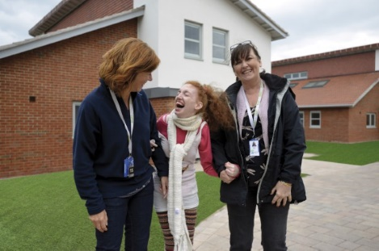
Seashell Trust
A New Chapter…
3rd October 2018
NATSIP National Working Day
Presented by Jolanta McCall - CEO/Principal

Slide 2
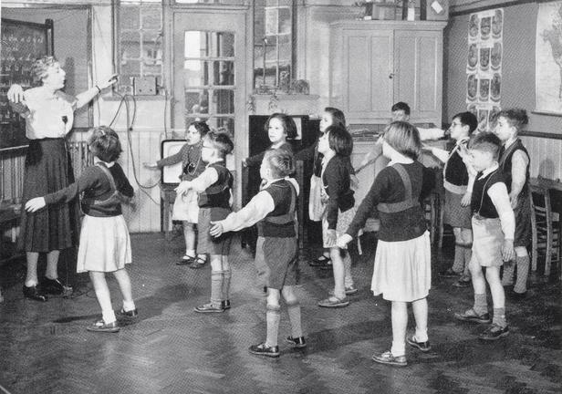
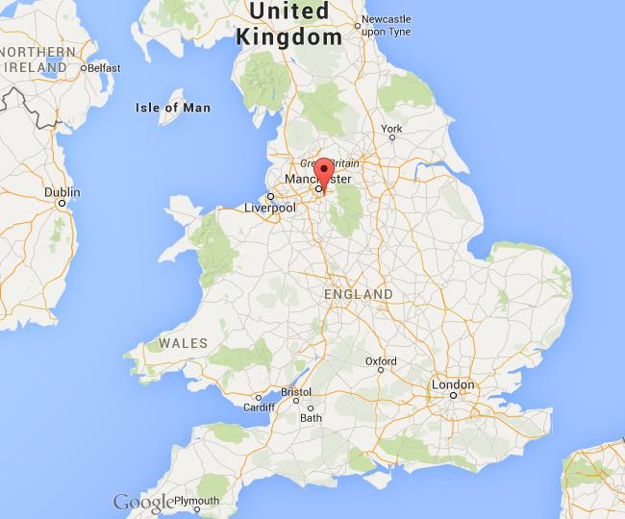
Seashell Trust
  National Charity since 1823
  Based in Cheadle Hulme, Stockport, in the
  North West of England
  Royal School Manchester, Royal College Manchester, Care services across 17 new residential homes, Outreach and Family services
  Our Vision
    For the children, young people and adults in our care to be safe, happy and to achieve the best possible life outcomes so that they are valued and valuable members of their communities
Notes:
National Charity that operates Family and Outreach services, a school, college and residential homes for children and young people with the most complex needs.
All pupils have severe and complex learning and communication difficulties and/or disabilities.

Slide 3
Seashell Trust - Education
  Royal School Manchester
  Royal College Manchester
 | 2013 | 2014 | 2015 | 2016 | 2017 | 2018
Deaf/SLD | 5 | 6 | 5 | 4 | 4 | 3
MSI | 14 | 10 | 12 | 16 | 16 | 13
Autism | 15 | 25 | 25 | 19 | 22 | 22
Other | 3 | 5 | 5 | 7 | 8 | 9
Total Numbers | 37 | 46 | 46 | 46 | 49 (50) | 47
 | 2013 | 2014 | 2015 | 2016 | 2017 | 2018
Deaf/SLD | 15 | 24 | 22 | 23 | 17
MSI | 3 | 7 | 3 | 5 | 4
Autism | 20 | 26 | 31 | 20 | 22
Other | 18 | 14 | 20 | 32 | 33
Total Numbers | 56 | 71 | 76 | 80 | 76 | 72
Notes:
The Royal School Manchester is a national resource, a residential, co-educational, non-maintained provision. All pupils admitted have EHCP.
Referral route: LA/social workers or families
Prospective pupils are assessed prior to entry to ensure they meet admission criteria
There are currently (September 2018) 47 pupil on roll, school is registered with the DfE for 50 places. Demand for places in 2018 now exceeds the remaining 3 placements as we have requests for 6 more placements for this school year.
The social and economic backgrounds of pupils within School are mixed with 15% people of black and ethnic minority families.
The School takes pupils from across the United Kingdom, representing 26 Local Authorities which makes up the School’s notional catchment area.
A higher proportion of referrals are being received from the NW region with 85% of the school population coming from this area from September 2018.
Children and young people attend as day pupils, several of whom access some short-break (respite) provision or as residential pupils. This includes weekly and termly boarding as well as 52 week placements to meet both individual and family needs
The School’s primary aim is to raise achievement and facilitate the progress of pupils through appropriate and effective communication systems thus enable them to make choices and decisions about their lifestyles and improve life outcomes
School offers an extended curriculum, including after school clubs, focused on the development of daily living skills including key skills, delivered through individualised programmes.
The severe, complex and diverse needs of the pupils, necessitates individually planned programmes of study and learning to take account of the distinct learning needs and styles of the students
All pupils have severe and complex learning and communication difficulties and/or disabilities.
RSM is now a Teaching School and National Support School Offer Initial Teacher Training (ITT) placements for SEND
Last year we improved our assessment processes in line with the changes in statutory assessment
now working to improve careers education for young people. We have recently improved our recording and evaluation processes
RSM along with college and care services have introduced active support to improve consistent strategies across education and care to enable our children and young people to live more independent lives.
We offer our staff opportunities for career progression and development within the trust. We have 14 trained Intervenors, The North West Intervenor network meetings and training programmes are hosted and supported by Seashell Trust. 10 ASC trained staff, and 9 out of our 15 teachers have mandatory qualifications in VI, HI, MSI.
RSM has developed the creative arts and outdoor learning provision and we are currently working towards gaining the Artsmark platinum award.
We have some strong links with local schools and local authorities. Both local special schools and LA’s support school improvements through participation in learning walks and OTL.
Stakeholders views are sought at annual review and through learning walks and questionnaires to staff, parents and local authorities.
School staff have published articles in SEN magazines, DBI International and BATOD. Staff have presented at National and International conferences.
School has been successful in the recent autism accreditation and are now applying for advanced accreditation for our practices in Autism.
Royal College Manchester is an innovative independent specialist FE college.
We have experience and expertise in supporting young people with severe or profound learning difficulties and severe or profound communication difficulties relating to one or more of the following conditions:
autism
deafblindness/multi-sensory impairments
hearing impairments
visual impairments
complex physical disabilities and/or additional medical needs, including degenerative conditions
All students have limited functional communication and, with the support of staff and our total communication approach, learn meaningful and effective communication strategies including speech, sign, Objects of Reference, PECS, intensive interaction and the use of technology to meet their individual needs

Slide 4
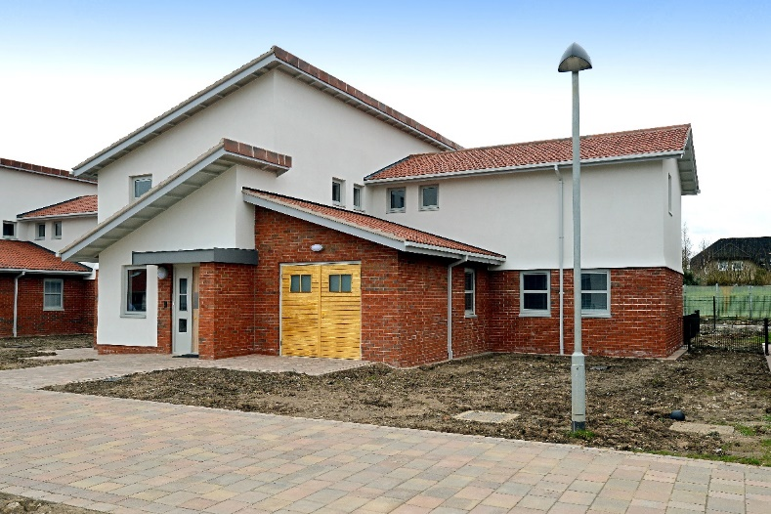
Seashell Trust –
Care Services
17 four bedroom houses (two and single storey)
Built in 2015/16
Specifically adapted for children and young adults with a range of disabilities
Provide a pleasant and attractive living environment in a community
Person-centred interior, displaying their own artwork and shopping for household items
Access to computers, Wi-Fi, Skype
Notes:
We take great care to ensure that each child or young adult has an appropriate peer group.
Social and Leisure Activities
Wide range of social and leisure activities on site and in the local community.
Activities focused on developing an independence and communication skills.
Everyone is encouraged to develop self-care and living skills in the home, including practical tasks such as shopping, cleaning, cooking and support to access the community.
We create opportunities for children and young adult to integrate into the community and make a positive contribution.
Activities on offer
We offer and encourage all our children and young adults to enjoy many new life experiences.
Activities include:
Fitness in our Accessible Fitness Suite
After School Club - Royal School Manchester offers weekly after school club sessions
Archery - support by qualified instructors
Athletics club
Bike club - with adapted bicycles
Cinema visits
Climbing club - supported by qualified instructors
Deaf club (if appropriate)
Music therapy delivered by qualified instructors
Religious needs of all denominations can be met by visits to and from religious services at church, mosque or synagogue as appropriate
Swimming - we have a fully-equipped, disabled-friendly swimming pool and hydrotherapy pool

Slide 5
Seashell Trust –
What’s Special…
  Children & YP with extremely high complexity of needs
  Children & YP and their family centered approach
  Highly skilled, enthusiastic and committed staff
  Community feel
  Innovative intervention
  Multi-disciplinary approach across all services
  Centre of expertise, autism accreditation from National Autistic Society
  RSM Teaching School and National Support School offering ITT placement for SEND
Notes:
ITT Initial Teacher Training

Slide 6
Seashell Trust –
Challenges …
  Referral to placement process
  Delays in confirmation of placement from LAs
  Cost of placements
  School physical environment – need for a new building
  High turnover of staff due to job demands
  Restructure of Care services

Slide 7
Parental Feedback
“My son has been at Seashell school since year 7, he's currently in year 13. He has received outstanding care and education during that time, with school programmes tailored precisely to his individual needs and delivered by dedicated, experienced and very skilled staff.”
“My daughter has made progress beyond all expectation, particularly in terms of her independence skills and ability to interact with others”
“Seashell Trust has always welcomed parents and other family members visiting, and we feel fortunate that our son has been able to spend such critical years there.”

Slide 8

Seashell Trust –
The Future
  Established centre of excellence and innovation for severe complex needs children & young people
  Research and innovation
  Use of technology
  Preferred early intervention provision
  Expanded outreach services
  Established early intervention holistic assessment centre
  Nationwide family support groups

Slide 9
Seashell Trust
A New Chapter…
3rd October 2018
NATSIP National Working Day
Presented by Jolanta McCall - CEO/Principal

