Slide 1
A continuum of Sensory provision
Deborah Rix
June 2018

Slide 2
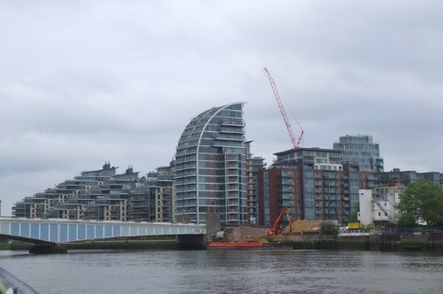

Understanding the local and regional need
Locally
A borough of contradictions
An increase in the number of children (0-15) in the Borough of 4,400 (15%) is projected between 2014 and 2019
The gap between rich and poor is greater than in 26 out of the other 31 boroughs
Wandsworth has the highest migration rates of any London borough
Wandsworth has the highest proportion of 25 to 39 year olds of any local authority nationally
“Bad deal. Wanted me to cut the ribbon-NO!”
£15 billion transformation with 20,000 new homes
Highest number of gangs in London
Region
The South West Thames Regional Genetic Services at St George’s University Hospitals NHS Foundation Trust provides a specialist service to people living in South West London, Surrey, and West Sussex
St Georges specialist Neonatal services cover wide geographical area from London to the South Coast
3 regional special schools in London
Deaf CAMHS

Slide 3
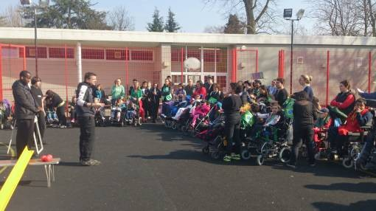
All through Continuum of Provision
Linden Lodge School – a regional school for children and young people with vision impairment 2-19 years
Alba Centre for Deafblind children and young people at Linden Lodge School
Habilitation service for the St Georges Auditory Implant programme
Wandsworth Hearing Support Service ( peripatetic team)
Wandsworth Vision Support Service (peripatetic team)
Habilitation team
Learning Resources Service for pupils with vision impairment
Willow Hearing Support base for deaf pupils 3 to 11
Rowan Hearing Support base for deaf pupils aged 11 to 19

Slide 4
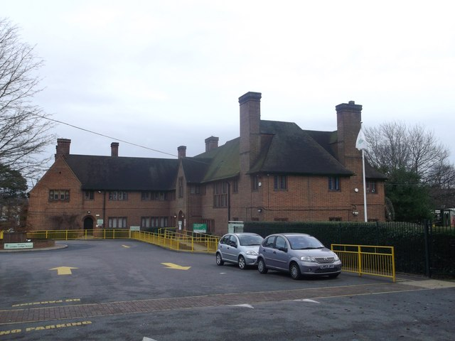
Specialist sensory workforce
27 teachers of the visually impaired (Linden Lodge School)
4 MSI teachers
4.4 fte habilitationists
2.6 fte peripatetic teachers of the visually impaired
2 teachers in charge of resource bases
4 Early Years peripatetic teachers of the deaf
Teachers of the deaf across settings

Slide 5
Planning the specialist workforce – key principles
Specialist sensory teachers of the deaf and MSI work across settings
Peripatetic teachers of the visually impaired work together with QTVIs from Linden Lodge on specialist programmes eg Braille teaching, playgroup, Sports
Focus on professional development both Mandatory training and ongoing specialist courses
Family Partnership Model to unify workforce approach and thinking
Continually adapting to changing rolls and trends

Slide 6
Influencing SEND
Identify vehicles of change
Family Partnership Model – Local Authority and beyond
Providing outcome data – Local Authority and beyond
Cost effective model of planning resources- Local Authority
Multi-disciplinary collaboration
Seamless provision for implanted children and young people – NHS
Single team with diverse roles – innovative practice
Expanding facilities eg Isobel Centre for parents and professionals
Identifying trends – new Centre at Linden Lodge/Alba Centre

Slide 7
Time to act
Articulating the need for sensory specialist teachers and resources
Creating the next generation of SI leaders
Educating Local Authorities regarding the need for specialist support
Re-visioning the special school
Developing advanced skills training
Greater collaboration between services

Slide 8
Future proofing
The expert
Experts don’t apply rules, or uses any maxims or guidelines. He rather has intuitive grasp of situations based on his deep tacit understanding. One key aspect of this level is that individual relies on intuition and analytical approach is used only in new situations or unrecognized problems not earlier experienced. Experience based deep understanding provides him very fluid performance. At this stage skills becomes automatic that even expert is not aware of it. Based on priori experience, they can even come up with solution for new never experienced before situations. "Experts" adopt a contextual approach to problem solving and understand the relative, non-absolute nature of knowledge. This ability distinguishes the "expert" from the "proficient" practitioner. Reflection comes naturally and experts solve problems almost unconsciously.
The Leader
(It is )Experts in the core business of the organization who make the best leaders. (Amanda Cass)
The Advocate

