Slide 1





















Whole School SEND Consortium
A growing community of practice of more than 4500 schools/settings and providers
Hosted by nasen, with strategic partner UCL Centre for Inclusive Education
Currently funded by DfE to deliver the SEND Schools’ Workforce contract
Committed to improving outcomes for children and young people with SEND by networking, collaborating and unlocking the answers that exist within the system

Slide 2
SEND Schools’ Workforce Contract
Aim 1
Drive education institutions to prioritise SEND within their CPD and school improvement plans including facilitating greater links between mainstream and special schools.
Aim 3
Build the skills of teachers working in mainstream and special schools and of SENCOs and teachers of classes of children and young people with sensory impairments by promoting best practice.
Aim 4
Identify and respond to any gaps in the training and resources available to schools.
Aim 2
Equip schools to identify and meet their training needs in relation to SEND.
Notes:
Current contract is until March 2020, but it may be extended until March 2022.

Slide 3

Aim 1: Drive education institutions to prioritise SEND within their CPD and school improvement plans including facilitating greater links between mainstream and special schools.
SEND Index
ITE SEND audit
supply, demand and drivers for SEND CPD
evaluation of contract and all individual strands
Hosting of resources, research and best practice on SEND Gateway
Research SEND (two conferences per year)
Open access special edition of nasen journals (one per year)

Slide 4

Aim 1: Drive education institutions to prioritise SEND within their CPD and school improvement plans including facilitating greater links between mainstream and special schools.
Support for local areas with written statements of action related to schools, following Ofsted/CQC inspection
Appointment of 8 Regional SEND Leaders and 8 Deputy Regional SEND Leaders and building capacity within the regions
Growing the community of practice to 10,000 schools by March 2020
Knowledge exchange conferences for special/mainstream schools (one per year)

Slide 5

Aim 2: Equip schools to identify and meet their training needs in relation to SEND.
Support for condition-specific organisations
Development of a ‘menu of solutions’ on the SEND Gateway
Rolling out of SEND Governance Review Guide
Delivery of MAT-level SEND Reviews
Testing of SEND Review in foundation stage and 6th form settings

Slide 6

Aim 3: Build the skills of teachers working in mainstream and special schools and of SENCOs and teachers of classes of children and young people with sensory impairments by promoting best practice.
Aim 4: Identify and respond to any gaps in the training and resources available to schools.
Review of learning outcomes for National SENCO Award
Review of the mandatory qualifications for specialist impairments
Creation of a SENCO induction pack
Creation of a Headteacher’s Guide for appointing and managing an effective SENCO
Support for condition-specific organisations
Developing a new platform to host the SENCO Forum

Slide 7
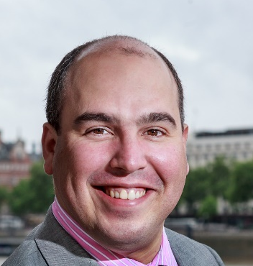
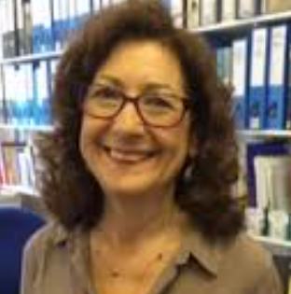
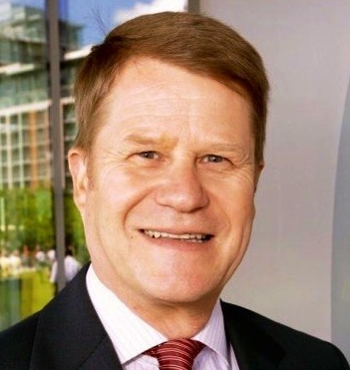
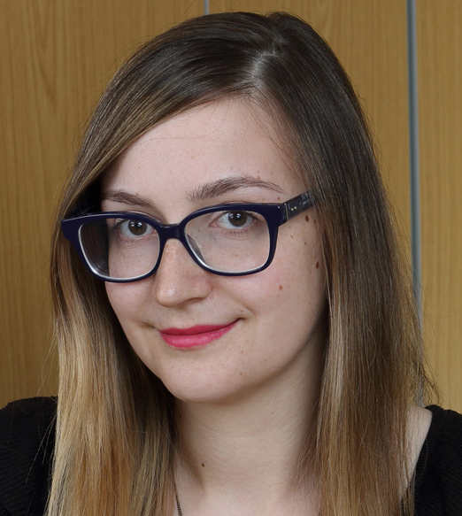
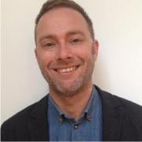
Team Structure: leadership and governance
Whole School SEND Programme Board (SEND Schools’ Workforce Contract)
Chair
Strategic Partner
Dr Adam Boddison
Gill Brackenbury
National SEND Leader
National Director
National SEND Leader
Malcolm Reeve
Anne Heavey
Simon Knight
4 Regional SEND Leaders
4 Deputy Regional SEND Leaders
Central Team
4 Regional SEND Leaders
4 Deputy Regional SEND Leaders
Notes:
The 8 RSC areas are:
East of England & North East London
North-West London & South-Central England
South-East England and South London
South West England
Lancashire and West Yorkshire
North of England
East Midlands and the Humber
West Midlands
Also worth mentioning others from the central team that are relevant to your audience: Charlotte Rains (WSS Director of Operations), Natasha Nimin (Programme Manager), Coral Stewart (Project Officer), Programme Assistant (TBC), Alex Grady (Education Development Officer). nasen strategic support: Dave Roberts (Head of Operations), Alison Wilcox (Head of Education), Gina Wookey (Head of Marketing). UCL key staff: Karl Wall (leading on research and evaluation).
NB: wider consortium and key players from there not on this diagram!

