Slide 1



SEND
Policy update
Caroline Cane
Assistant Director
SEND, Alternative Provision and Attendance Unit
Notes:
1

Slide 2





What we want to achieve for children and young people with SEN and disability
We want children and young people with SEN and disabilities to:
achieve well in the early years, at school and in college;
find employment;
lead happy and fulfilled lives; and
have choice and control over their support.

Slide 3
Major reforms to the SEND system in 2014
The Children and Families Act 2014 recognised that support must be joined up effectively across education, health and social care, where necessary from birth to 25
Problems with the SEND system had built up over time, including:
The Act and the statutory SEND Code of Practice introduced major changes, particularly for the 2.8% with Statements, which must be fully implemented by April 2018
  0-25 system
  EHC plans
  Person-centred and co-produced
  Local Offer
  Joint commissioning
  Independent Supporters
  Parent Carer Forums
  SEN support replaced ‘school action’ and ‘school action plus’
  Young Offenders
  Personal budgets
  Review of disagreement resolution
  Adversarial system with parents ‘fighting’ for what their children needed
  Inadequate information about, and access to, services
  Poor coordination of services across education, health and social care, and from child to adult services
  Inefficient use of resources and poor outcomes
In parallel changes were brought in to the funding system for those with SEND (funding from schools block and high needs)
  More consistency in the approach to funding pre- and post-16 high needs – local authorities responsible for commissioning and funding students with high needs in FE (up to age 25) as well as in schools
  System of annual core/place funding for institutions plus “real-time” top-up funding to reflect additional costs of supporting pupil/student
  Schools required to meet SEN costs up to £6k from their normal budget

Slide 4
Reform Implementation: Headlines
£391m has been invested since 2014 for local areas to implement the reforms
98.4% of Statements of SEN were reviewed by the 31 March 2018 deadline
2 year National Trial started in April, expanding powers of the First Tier Tribunal
Established local supported internship forums and training more job coaches
Delivery support provided by the DfE specialist SEND Advisers and other partners

Slide 5
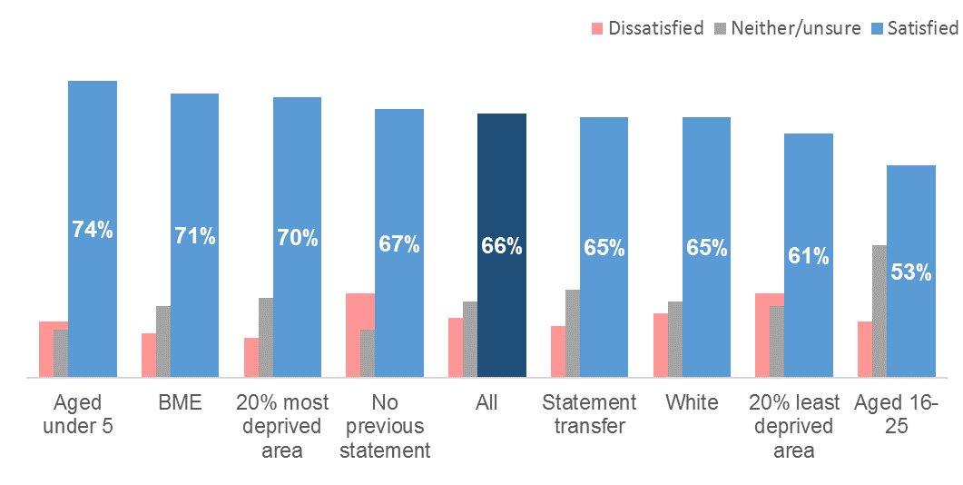

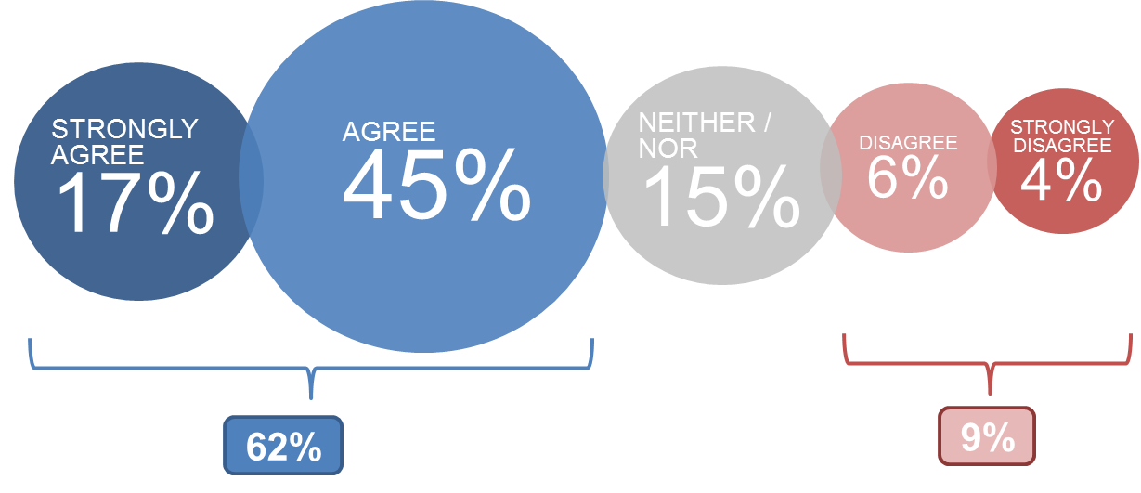
Reform Implementation: User surveys
Overall satisfaction with EHC process
Two thirds said they were satisfied or very satisfied. This varied by demographic categories, type of SEN, and by local area.
Will EHC plan achieve agreed outcomes?
Views on impact
Almost three quarters agreed their plan had led to the child or young person getting the help and support needed and over two-thirds agreed that their plan had improved the child or young person’s experience of education.
*Rounding
Source: EHC plan experiences: a survey of parents and young people (DfE, 2017)

Slide 6
Reform Implementation: Local Area inspections
59 local area inspections of SEND services have been carried out to date. We are supporting the 25 LAs to respond to their Written Statement of Action through the DfE’s professional SEND adviser team and the NHS England regional adviser team
“Parents of children whose needs were identified early were positive about the support they received” (based on 30 inspections)
Ofsted and CQC, Local area SEND inspections: one year on, Oct 2017
Greenwich
Since the reforms, schools and parents report that the views of children are better captured during the EHC plan assessment process. The EHC plan has the child at its heart and some professionals report the process as being ‘cathartic’. Young adults feel central to their EHC plan.
Wiltshire
Senior leaders in the local area from education, health and social care are working together constructively to deliver and improve services for children and young people who have special educational needs (SEN) and/or disabilities. They demonstrate ambition to deliver high-quality outcomes for children and young people, despite the increasing demands on budgets and financial constraints. As a result, they have detailed and appropriate plans in place to tackle their key priorities for improvement.
Cheshire East
The proportion of young people who are in paid employment is much higher than the national average. This is as a result of the local area’s work to engage with the various employers and local businesses.

Slide 7
Specialist teachers of children and young people who are deaf and/or visually impaired provide valued support to pupils with sensory needs placed in mainstream schools. Additional specialist support and services are located within the borough and in nearby areas. Parents were mostly positive about the quality of this support.
Timely assessment for those with sensory impairments results in swift and appropriate interventions which meet the needs of this group of children and young people well.
The Integrated Physical and Sensory Service provide effective support and many health professionals give detailed and helpful advice. As a result, some schools and settings are identifying children and young people’s needs precisely and in a timely way.
Parents of children with sensory impairment report prompt and accurate identification of their children’s needs.
……but there is more to do, access to occupational therapy specialist services is highlighted is an issue in a number of reports.

Slide 8
Supporting reform delivery 2018-19 and beyond
Support to LAs:
  High Needs Block increasing by £142m in 2018/19 to £6 billion
  £251m of capital to create new specialist places
  £9.7m for Supported Internships
  Team of SEND advisers
Support to the workforce:
£3.4m to embed SEND within schools and deliver quality teaching across all types of SEN
Funding Educational Psychologists’ training
Support to parents, children and young people:
  £20m for individual advice, support and information on services available
  Funding for Parent Carer Forums, including support for National Network of PCFs and a helpline
  Strategic engagement support for parents and young people

Slide 9
Going forward: Ministerial Priorities
World-class
For a more productive economy...
education, training, care...
...and so everyone has the chance to reach their potential
and live a more fulfilled life
...for everyone,
whatever your background
What
How
  Academic standards to match key nations
  Technical education to rival Germany’s
  Character, resilience and well-being
Recruit, develop & retain the best people
Prioritise the most disadvantaged
Autonomy within clear boundaries
Make every £1 count

Slide 10
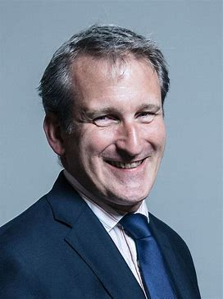
“This government is committed to ensuring that every child – regardless of their circumstances – can benefit from their education, ensuring they have the knowledge and skills to fulfil their potential, and the resilience they need for future success.”
16 March 2018
Announced a programme of work to improve our understanding of the educational experiences and outcomes of all children with additional needs, and those who live in challenging circumstances
Committed to setting out how the government will continue to work to achieve the vision of a reformed SEND system as part of the response to the Lenehan Review later this year

Slide 11
PRESSURES
PRIORITIES
EVIDENCE
Sufficient, high quality education provision
The right non-education support in place
The right support and incentives to support SEND
People with the right skills to support SEND
Engaged and informed customers/users, with effective redress if needed
Better employment outcomes
High quality evidence of how the system is functioning and what works
Education Select Committee
Increase in the proportion of those with EHC plans in non-mainstream provision
SEND Sector/stakeholders
Ofsted
Increase in the number and cost of EHC plans
Independent reviews
Increase in education funding substituting for health funding
Media

