Slide 1
Sensory impairment and sensory integration- the same or different?!
Dr Gail Deuce
NatSIP National Working Day
6th February 2018

Slide 2
Our senses
Sight
Hearing
Touch (passive and haptic perception)
Taste
Smell
Proprioception
Vestibular

Slide 3
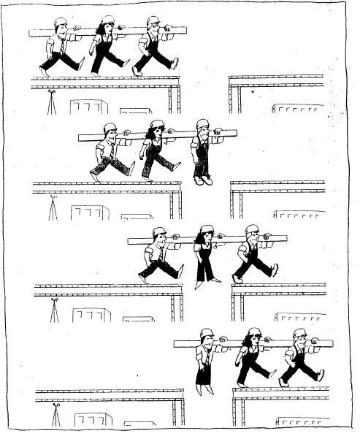
Teamwork

Slide 4
Receiving and responding to sensory information
⇨ ⇨
Sensory
receptors
Sensory
pathways
Sensory
processing

Slide 5
Sensory Integration
Taking in information
simultaneously
through our different senses
Make a response appropriate
to the situation
Organising and processing
the information

Slide 6
Sensory integration dysfunction/ sensory processing difficulties

Slide 7
Estimated rates of sensory processing disorders for children with various disabilities have been derived from reliable and valid survey results and are reported to be as high as 40-88%
(Ahn et al, 2004, p.287)

Slide 8
Possible functional impairments resulting from sensory integration dysfunction/sensory processing difficulties
Difficulty engaging in goal-directed behaviour
Poor social skills (including play)
Poor self-confidence and self-esteem
Poor gross and fine motor skills
Lack of the development and use of adaptive responses
Poor daily life skills
Difficulty regulating arousal levels

Slide 9
Difficulties with self-regulation
Physiological
Cognition
Emotional
Behaviour

Slide 10
How should we respond?
Work together with a therapist who has expertise in this area
Build up your understanding of what activities are arousing or calming
Be observant and responsive
Be prepared to be flexible
Provide regular sensory breaks and opportunities to engage in large movement
Identify what sensory components support/prevent the child’s ability to do a task
Ensure conflicting demands are not being placed on the child

Slide 11
Useful resources
Bogdashina O (2016) Sensory perceptual issues in Autism and Asperger Syndrome London:Jessica Kingsley Publishers
Brown D (2008) The sensory integration perspective and what it offers us in the field of deafblindness (Part 1) DbI Review July-Dec pp. 22-26
Brown D (2009) The sensory integration perspective and what it offers us in the field of deafblindness (Part 2) DbI Review Jan-Jun pp. 4-9
Kranowitz CS (2005) The Out-of-Sync Child
www.Wholechildtherapy.com resources

Slide 12
gaildeuceconsultancy@gmail.com

